Slide 1
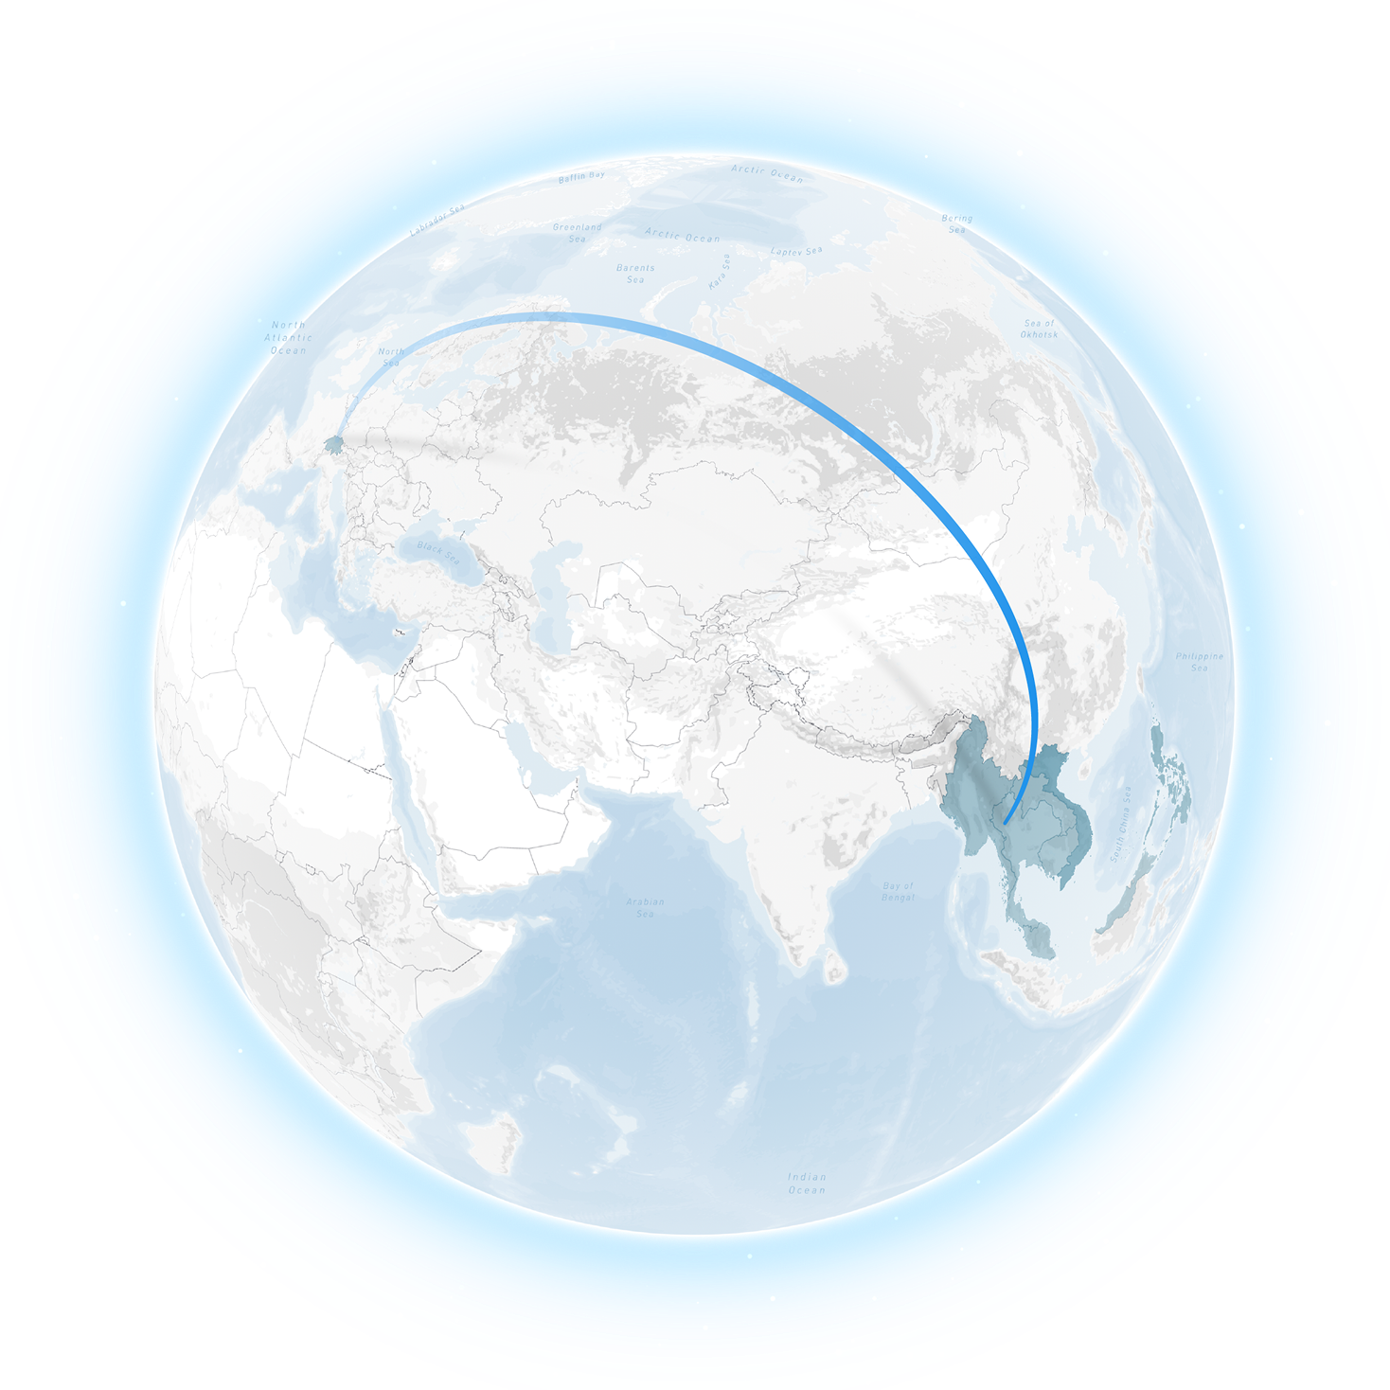
Swiss cooperation in the Mekong region in an ASEAN context
Building Bridges for a Sustainable Future
Switzerland is proud to partner with countries in the Mekong region to tackle shared development challenges by leveraging decades of experience in fostering inclusive growth, sustainability, and regional cooperation to advance sustainability. Together, we aim to turn challenges into opportunities for millions, and ensure a peaceful, stable and prosperous Southeast Asia Region.

Slide 2
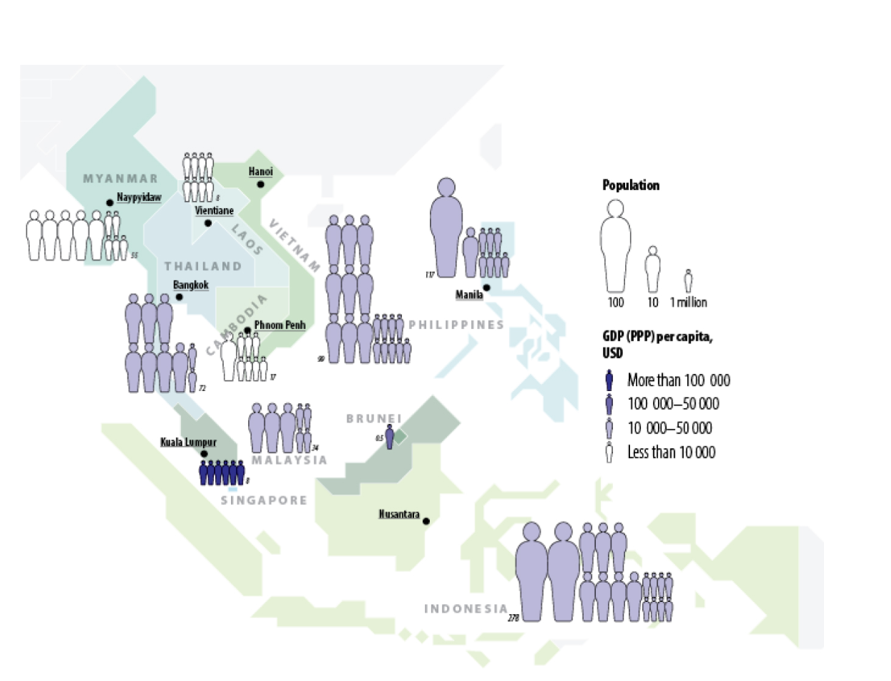
Countries, Demography and Economy
ASEAN, a Global Powerhouse
The Association of Southeast Asian Nations - ASEAN - is a collective of 10 nations with nearly 680 million people. The region is a critical hub for global trade and innovation, and is the world’s fastest-growing internet market. Celebrated for its cultural and natural richness, and despite its relatively small size, rich in biodiversity, ASEAN nevertheless faces pressing challenges from climate change, increasing energy demands, and economic disparities among its members.

Slide 3
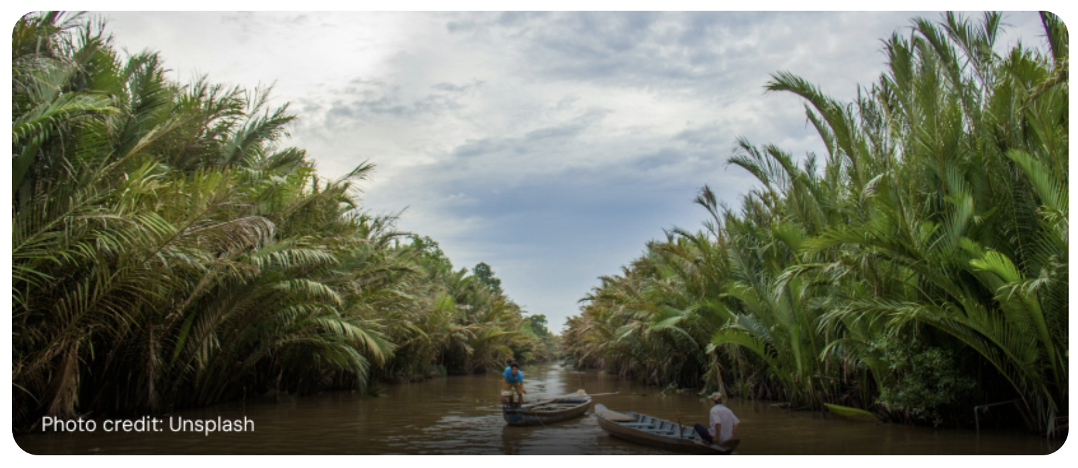
Cultural Diversity, Economic Growth and Environmental Challenges
A Global Hot-Spot
Cultural Diversity
Biodiversity
Economic growth
Demographics
A Tapestry of Languages and Cultures
Globally Significant Ecosystems
An Economy on the Rise
Leading the Change
1,200+
18%
5.3%
213 Milionen
languages
of known species / Globally
growth over the past decade
youth
ASEAN is home to unparalleled cultural richness, with more than 1,200 languages spoken daily, reflecting the diversity and vibrancy of its communities.
Despite covering just 3% of the world’s land area, the region hosts 18% of all known plants and animals, and is an internationally recognized biodiversity hotspot.
Collectively, the ASEAN countries represent the fifth largest economy in the world.
With 213 million people aged 15-34, the region boasts a dynamic, youthful population driving innovation and shaping the region’s future.

Slide 4
Switzerland and ASEAN
A stable and enduring Partnership
$ 28.5 billion
trade value between ASEAN and Switzerland in 2023
In 2023, Switzerland was the ASEAN region’s ninth largest source of foreign direct investment (USD 5.2 billion) fostering economic growth, sustainability, and integration into global markets, and the merchandise trade between the ASEAN countries and Switzerland amounted to USD 28.5 billion. Switzerland has also worked with countries in the region for more than 60 years, and has been a steadfast partner to ASEAN since its establishment in 1967. Over this period, Swiss development assistance of USD 3.1 billion has focused on addressing inequalities, empowering marginalized communities, and promoting long-term regional stability.

Slide 5
Mekong Region Matters
Challenges and Opportunities
The Mekong region’s strategic location, economic dynamism, young population and abundant natural resources provide opportunities for creating a prosperous, resilient, and sustainable future of the larger ASEAN region, but challenges remain.

Slide 6
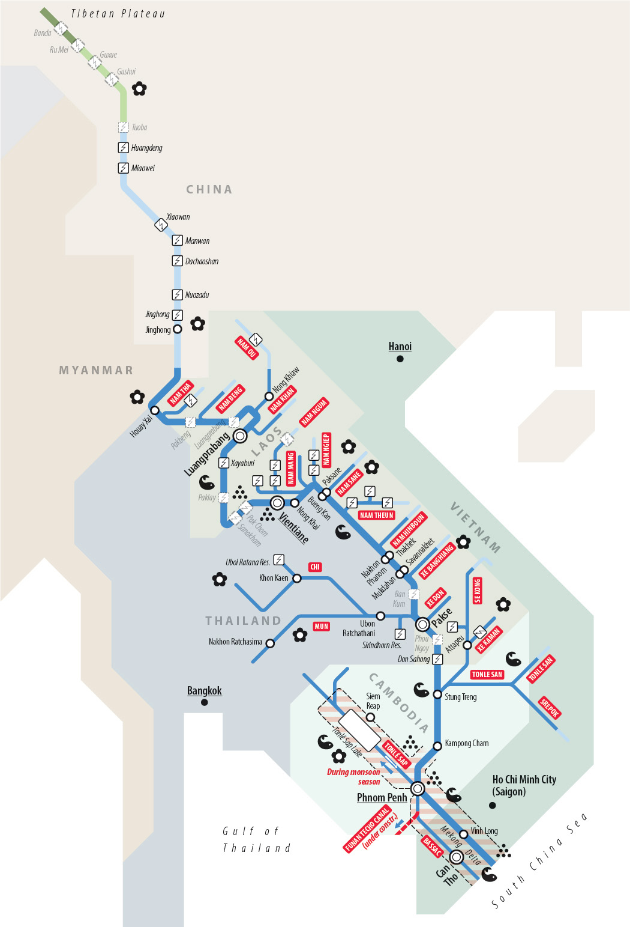
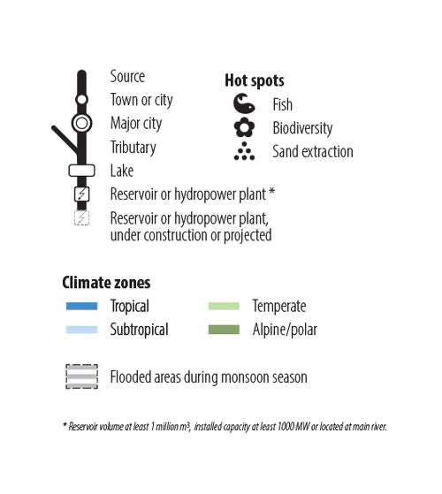
Connectivity
At the crossroads of China, India, and mainland Southeast Asia, the Mekong River is the focus of numerous mega-connectivity initiatives.
The Mekong river Metro-style map shows the basin, its water flows, dams and environmental challenges in an impressive and easily readable manner. Let’s use these multi-layered connections to address the challenges of the 21st century.
Source: Zoï Environment

Slide 7
Cornerstone of prosperity
The Mekong region sustains a significant portion of the ASEAN region’s population, and is a cornerstone of regional prosperity. Known as Asia’s rice bowl, it sustains food security through abundant fisheries and agriculture, supported by over 1,000 fish species and 20,000 plant species. With a hydropower capacity of 36,058 MW set to double by the 2030s, it is also a critical driver of energy and economic growth.
Annual production
20,000
1,000
93,000
plant species
fish species
GWh / annually

Slide 8
Development Gap
Among the poorest of the Mekong, Cambodia, Laos and Myanmar account for one-quarter of the total land area that ASEAN covers and 12 per cent of the region’s total population, but together these three countries contribute only about 4 percent to ASEAN’S total GDP and only 2 percent to the value of its export trade in goods.
Cambodia, Laos and Myanmar
12%
4%
2%
of ASEAN’s total population
of ASEAN’s total GDP
of ASEAN’s export trade in goods.

Slide 9
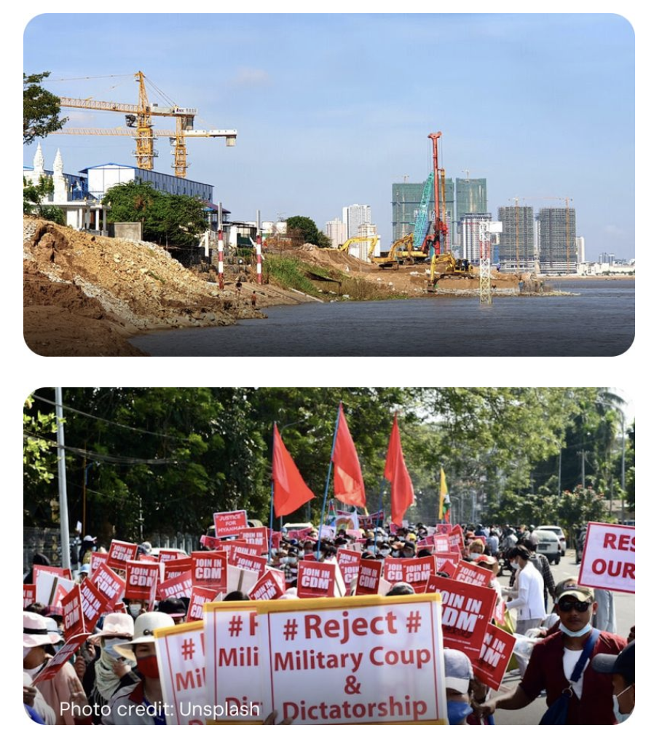
Mekong River Environment
The Mekong River is a lifeline for more than 70 million people, yet faces growing risks from climate change, dams, and resource extraction. These pressures threaten its biodiversity, disrupt ecosystems, and endanger food security and livelihoods in the ASEAN.
Peace and stability
Stability in the Mekong is vital for peace and prosperity in the wider ASEAN. Challenges such as resource governance, resource extraction, and political crises – most notably in Myanmar – require coordinated efforts within ASEAN and beyond.

Slide 10
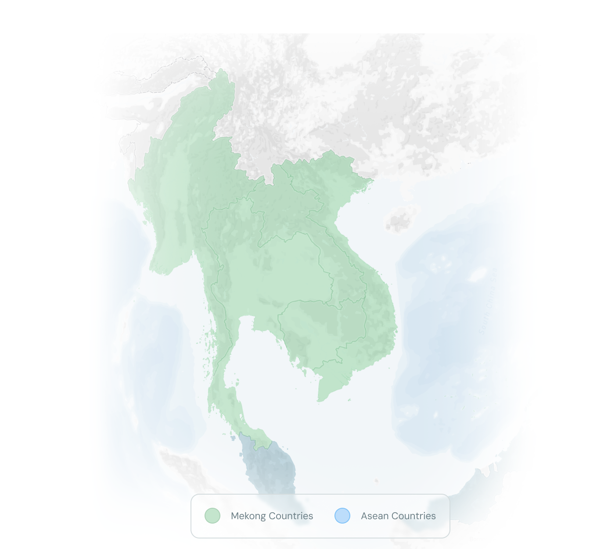
Driving Change in the Mekong
Transforming Challenges into Opportunities
Forest:
Increased control over forest resources for 1.8 million households, and improved income and food security for more than 100,000 smallholders.
Transboundary Water management:
Switzerland actively supports Mekong countries in addressing the prosperity gap within ASEAN. With USD 1.97 billion invested since 1964, Switzerland’s programs focus on sustainable development, natural resource management and citizen participation.
Switzerland supports the Mekong River Commission, which promotes transboundary cooperation to improve water management, biodiversity and the livelihoods of millions of people along the river.
Skills mobility:
150,000 migrant workers have access to skills development and recognition, and job referrals, leading to better employability and livelihoods.
Partnership brings tangible results.
More than 60 years of Swiss cooperation with the Mekong countries.

