Slide 1
Exposure to mercury affects everyone, but often in different ways
WHO
considers mercury as one of the TOP TEN chemicals of major public health concern.
The Minamata Convention identifies women and children as vulnerable populations:
“health concerns, especially in developing countries, resulting from exposure to mercury of vulnerable populations, especially women, children, and, through them, future generations”

Slide 2
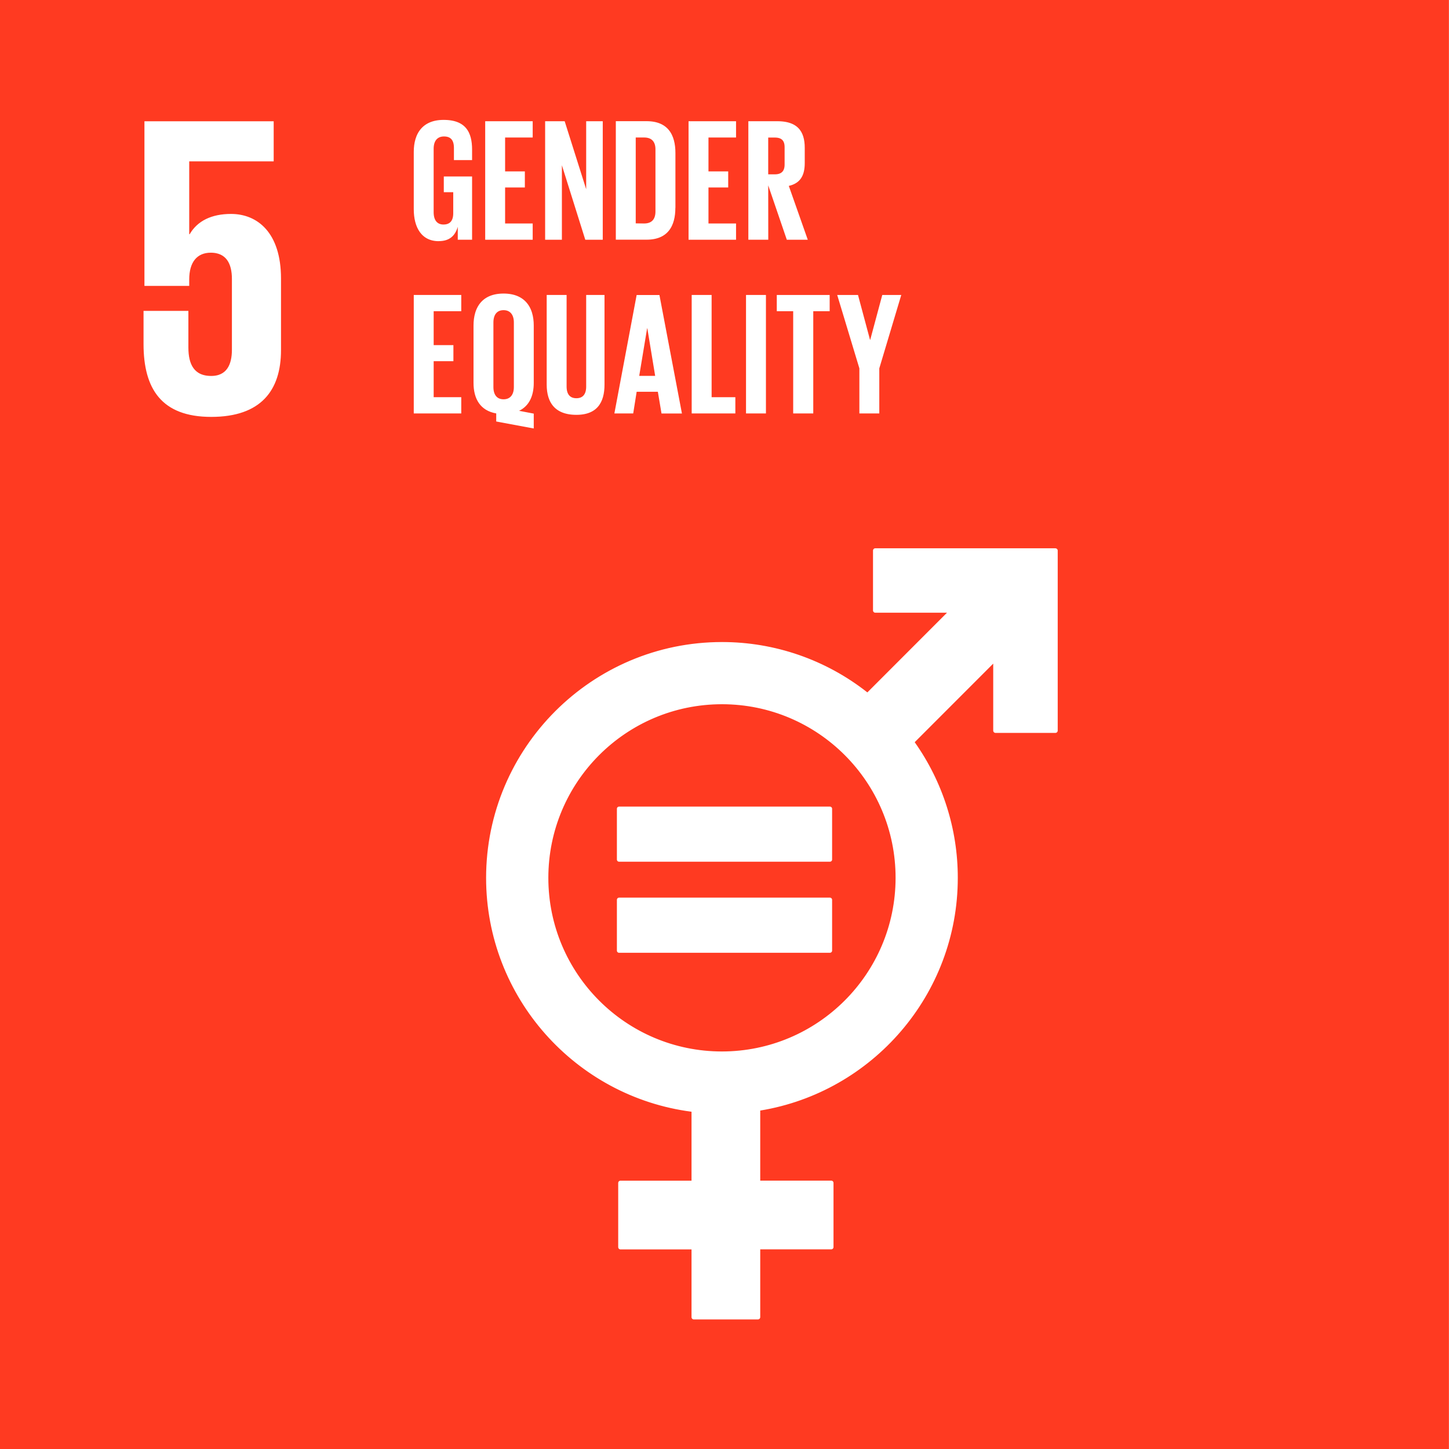
Physiological differences mean that mercury exposure affects men, children and women differently
Exposure of women to mercury may produce hormonal disorders and reduced fertility; exposure in pregnant women will affect fetal and infant health.
Men’s exposure also can affect their reproductive health. Chronic exposure results in nervous system toxicity and neuromuscular effects.
Children are at an increased risk from exposure to mercury due to their rapid development and dynamic periods of growth. Mercury exposure transferred during fetal development can cause lifelong harm. Children exposed to 10 - 20% of the toxic level of methylmercury seen in adults can have cognitive deficits as early as ages 4 to 7.

Slide 3
Exposure to mercury
affects everyone, but often in different ways
Gender norms drive gender-differentiated exposures and risks
Gender roles and norms mean that women and men often encounter mercury exposure in different occupational activities.

Slide 4
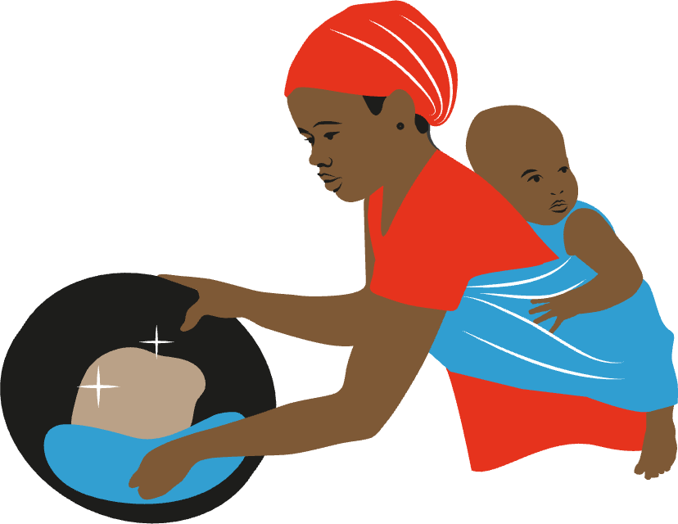
Artisanal Small-Scale Gold Mining (ASGM)
An estimated 30% of the world's estimated artisanal gold miners are women.
Men typically do the heaviest labor mining tasks.
It is mostly women who work in processing activities, using mercury to separate the gold from its sediment or soil.
This puts women and their dependent children, who often accompany them to the work sites where the mercury is burned off to purify the gold, at especially high mercury exposure risk. It also means that women may have distinctive perspectives on how to clean up or phase out the use of mercury in these kinds of processes

Slide 5
Exposure to mercury
affects everyone, but often in different ways
Gender norms drive gender-differentiated exposures and risks
Gender roles and norms mean that women and men often encounter mercury exposure in different everyday uses,
such as consumer products.
Around 30% of the global demand for mercury comes
from its use in consumer products

Slide 6
Mercury containing consumer products cause direct human exposure to mercury
Mercury-based skin-lightening products (SLPs) are marketed aggressively and used commonly mostly across much of the Global South, especially by women.
Mercury-based skin-lightening cosmetics are corrosive to the skin, eyes and gastrointestinal tract, and can induce kidney toxicity and can result in a wide range of neurological, systemic and reproductive disorders. It is not just the users but their family members, especially young children, who may be exposed from skin contact.
In a significant
move to combat the use
of mercury in cosmetics
globally, the fifth meeting of
the Conference of the Parties to
the Minamata Convention on
Mercury (COP-5) amended the
Convention text to explicitly ban manufacture, import and
export of mercury-added
cosmetics.

