Slide 1
Training module:
Bringing a gender lens into work programmes of the Minamata Convention
November 2024

Slide 2

Welcome to the gender
& mercury training session
Together, we will explore:
some of the core concepts of gender equality and mainstreaming
some of the relationships between gender and mercury exposure, production and disposal
how gender mainstreaming and gender inclusion can amplify your work to protect human health and the environment from anthropogenic emissions and releases of mercury and mercury compounds*
how to put gender mainstreaming into practice in projects under the purview of the Convention
* this is the primary objective of the Minamata Convention

Slide 3
Contents
1
4
MODULE
MODULE
Basic concepts
The Minamata Gender Action Plan
2
5
MODULE
MODULE
Why gender in the Minamata Convention?
Mainstreaming gender in capacity-building projects: practical approaches
3
6
MODULE
MODULE
A closer look at gender and mercury
women of child-bearing age; skin-lightening products; seafood contamination; ASGM
Further resources

Slide 4
1
MODULE
Basic concepts

Slide 5
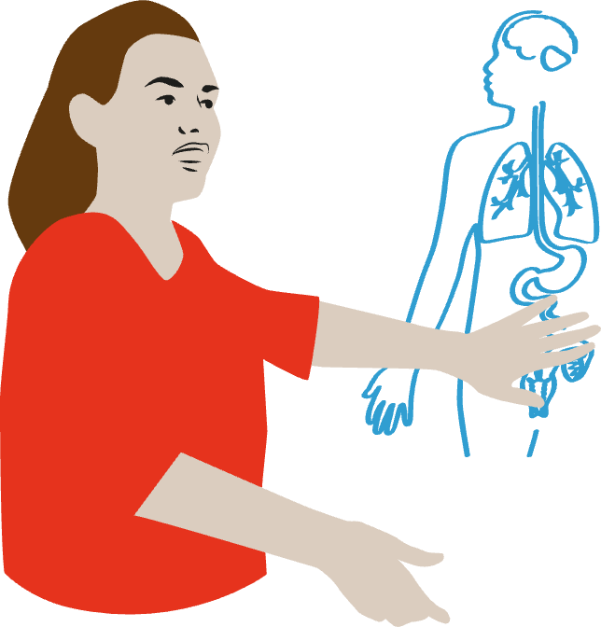
Starting with the basics
Sex refers to the different biological and physiological characteristics of females, males and intersex persons, such as chromosomes, hormones and reproductive organs.
Gender refers to the characteristics of women, men, girls and boys that are socially constructed. This includes norms, behaviours and roles associated with being a woman, man, girl or boy, as well as relationships with each other. As a social construct, gender varies from society to society and can change over time.
1
MODULE

Slide 6

Why do we focus on gender?
Because gender identities are created by cultural norms and learned through socialization processes, they can also be changed. They are context/time-specific and changeable.
To achieve women’s empowerment and equality between women and men, gender roles and norms often must change.
Gender is part of a broader socio-cultural context. Other important criteria for social analysis include class, race, poverty level, ethnic group and age.
1
MODULE

Slide 7

Other concepts you might encounter
Gender analysis: A critical examination of how differences in gender norms, roles, power structures, activities, needs, opportunities, and rights affect women, men, girls, and boys in a certain situation or context.
Gender lens: Takes the existing
differences between women and
men into account when analysing
a situation or when developing
specific approaches
or programmes.
1
MODULE

Slide 8

And... equity and equality
Gender equality is achieved when women and men, girls and boys, have equal rights, life prospects and opportunities, and the power to shape their own lives and contribute to society. Equality does not mean that women and men will become the same; rather, that rights, responsibilities, and opportunities of women and men will not depend on whether they are born male or female.
A gender equal society will also be equitable. Equity refers mainly to fairness and the need for differential treatment in order to achieve a fair outcome in an unequal society. Equity is typically considered to be a means, where equality is the end.
1
MODULE

Slide 9
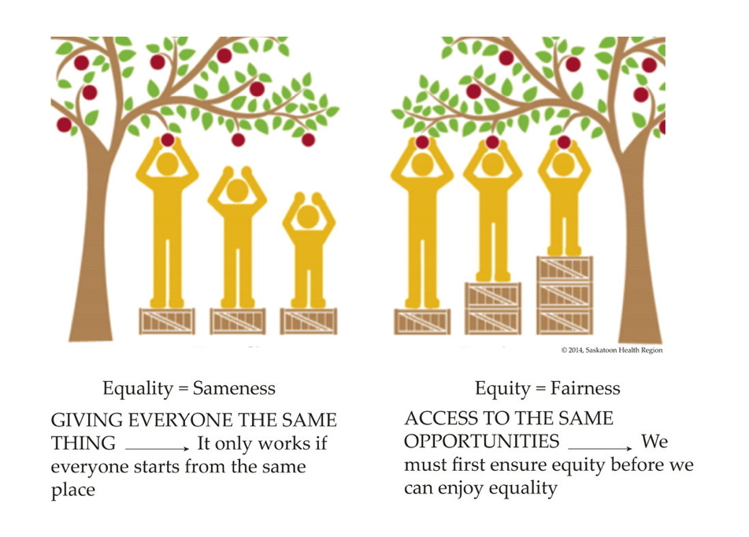
Equity or equality?
This illustration* shows the difference between “equality” and “equity.” Achieving equity often means taking into account the special barriers that marginalized groups might face.
* illustration from “16 days of activism”: https://16daysactivism.genwest.org.au/challenges/actions/learn-what-the-patriarchy-is/
1
MODULE

Slide 10
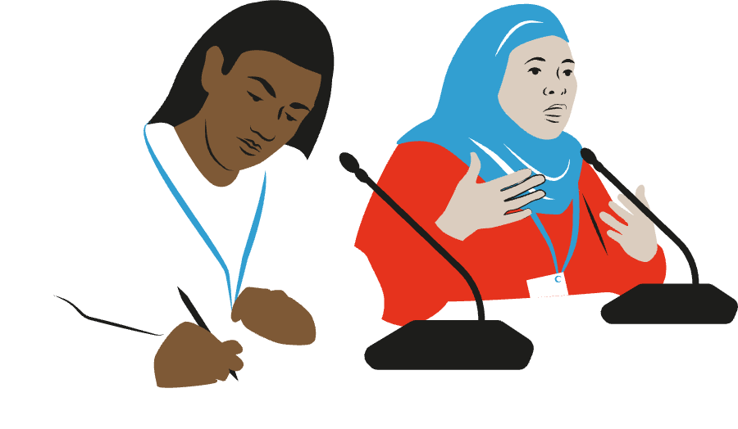
Gender mainstreaming
Assessing the implications for women and men of a planned action, including legislation, policies, or programs. It is a way to make women’s, as well as men’s, concerns and experiences an integral dimension of the design, implementation, monitoring, and evaluation of policies and programs so that women and men benefit equally and that inequality is not perpetuated.
The ultimate goal is to achieve gender equality.
1
MODULE

Slide 11
Exercise 1
1. Ask participants to make a list of some gender norms they encounter in their everyday lives. (the presenter might provide examples: are bank tellers overwhelmingly men or women? are girls in school required to learn about “home economics” while boys are taught wood-working or carpentry? are girls in most households expected to help with housework while boys are not? women aren’t “supposed to” operate heavy machinery such as tractors or bulldozers)
and
2. Ask participants if they are aware of gender roles that have changed in recent years (again, ‘nudge’ examples might include: it’s not unusual now for women to be police officers; it’s not unusual now for men to be nurses; bartenders used to be all men but now women are bartenders too; women and men are now almost equally represented in the national Olympic teams, etc)
divide the participants into small groups to do this exercise -- having 3 or 4 people at the same table can stimulate ideas for everyone. put these lists on flip charts, and go around the room to go through them very quickly.
A good discussion to follow up might be to ask people to explain WHY they think these gender norms have changed and what influences produced these changes? WHAT ARE/ WERE THE DRIVERS OF GENDER ROLES CHANGES? (laws? organizing by women’s groups? eTc)
Notes:
NOTE TO PRESENTERS: THIS IS A GOOD PLACE TO STOP AND DO AN INTERACTIVE EXERCISE

Slide 12
2
MODULE
Gender and the Minamata Convention

Slide 13

So, why are we talking about gender in our work under the umbrella of the Minamata Convention?
2
MODULE

Slide 14

International mandates and expectations
Gender equality is at the core of global human rights aspirations and United Nations values
More specifically, within the UN system special mandates require member states to work towards gender equality and women’s empowerment, including the SDGs, CEDAW (to which most states in the world are signatories), and “whole
of society” commitments
In environmental domains,
the Global Environmental Facility (GEF) and UNEP maintain robust gender equality expectations
for any project they fund or collaborate with
2
MODULE

Slide 15
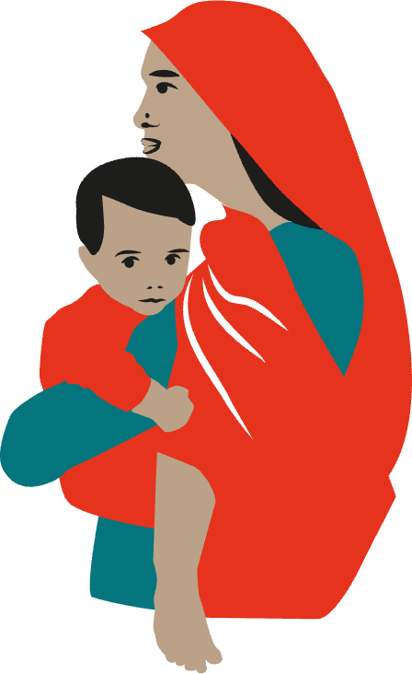
Gender equality is embedded within the Minamata Convention
Preamble
The preamble to the Minamata Convention on Mercury notes the Parties’ awareness “health concerns, especially in developing countries, resulting from exposure to mercury of vulnerable populations, especially women, children, and, through them, future generations”
Convention Articles
In addition, Article 16 on health aspects,
Article 18 on public information, awareness
and education, Article 19 on research,
development and monitoring and Article 22
on effectiveness evaluation all refer to
the needs of vulnerable populations.
2
MODULE

Slide 16
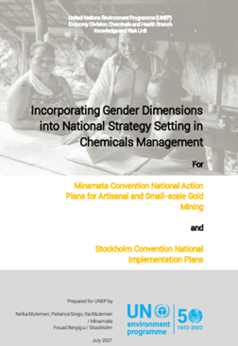
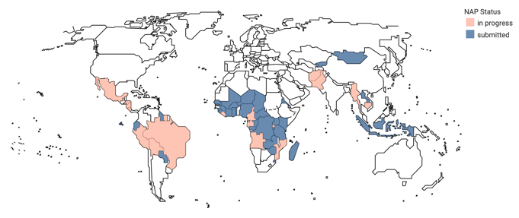
National Action Plans for ASGM
National action plans to address artisanal and small-scale gold mining (ASGM) must include strategies to prevent the exposure of vulnerable populations, particularly children and women of childbearing age, especially pregnant women, to mercury used in ASGM.
Unique among MEAs in the treatment of an informal sector
Recognizes women’s particular vulnerabilities to ASGM occupational hazards
Flexible approach to meet national and local circumstances
2
MODULE

Slide 17


Beyond being ‘expected’ to integrate gender into our work...
projects to reduce the harms of mercury and phase it out will be more effective
if you take gender dynamics into account, because...
all aspects of mercury production, exposure, waste are gender-differentiated
...as are perceptions of risk, knowledge about mercury
and its risks, willingness to/
opportunities to change
mercury practices
and if you take these dynamics into account, your work will be smarter
2
MODULE

Slide 18
Gender mainstreaming is a win-win
Gender mainstreaming means that your work will contribute to global – and local – human rights advances as well as enabling you to more effectively meet your project goals
2
MODULE

Slide 19

A closer look at gender-differentiated mercury exposure
Everyone is exposed to mercury to some extent, but one of the greatest concerns focuses on women of child-bearing age:
Exposure of women to mercury results in a higher incidence of hormonal disorders, reduced fertility and impact on fetal and infant health.
  Exposure of women of child-bearing age is of special concern because of its impact on future generations. Mercury in maternal blood is directly transferred to a developing fetus through the placenta, and usually cord blood levels are slightly higher than those in the mother’s blood system.
  The Minamata Convention pays specific attention to these effects on women and incorporates the need to establish strategies to prevent the exposure of vulnerable populations to mercury found in: artisanal and small-scale gold mining (ASGM), seafood consumption, dental amalgam, skin whiteners, and emissions from coal-fired power plants and other industries

Slide 20
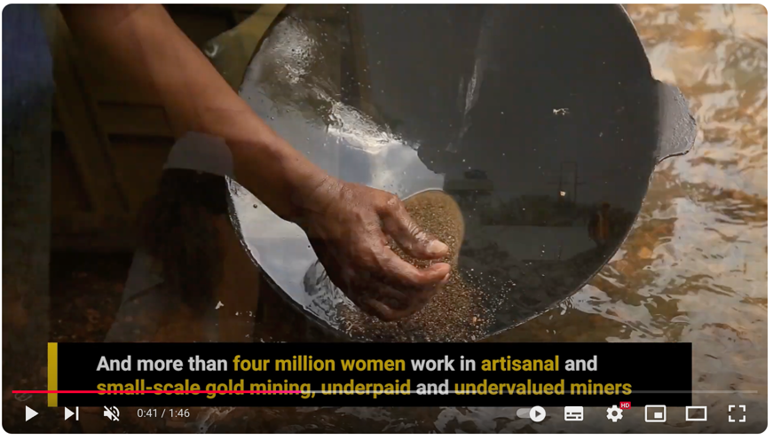
Note to presenters
Show this film, “making gender inequality and mercury history”
https://m.youtube.com/watch?v=CiM0dmGr1Gs

Slide 21
3
MODULE
Gender and Mercury

Slide 22
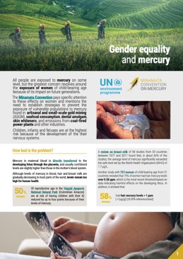
Gender and Mercury
The Secretariat has developed several resources on this topic:
An insight publication on gender and mercury
A Minamata online session (2021) on gender equality in the implantation of the Minamata Convention
An INFORMEA learning course on mercury and gender (2022)
An article titled ”A gender
perspective on artisanal and
small-scale gold mining under
the Minamata Convention on
Mercury" was also published
in the fourth edition of the
UNEP-OHCHR Bulleting
(October 2022).
3
MODULE

Slide 23
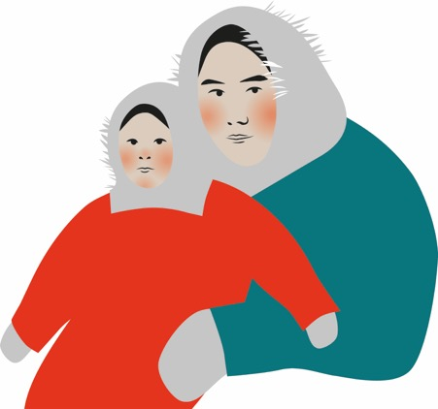
Mercury in seafood
A significant source of exposure is contamination of seafood by mercury that circulates globally, far from its original source of emissions. The human health danger of eating mercury-contaminated fish is amplified in pregnant women and young children.
Women in Small Island Developing States and in Arctic regions far from source emissions have very high hair levels of mercury, well above levels linked to neurological
damage in the fetus and cognitive
losses in children.
3
MODULE

Slide 24

Skin-lightening products
The intersection of racialized and feminized beauty ideals is readily apparent in patterns of SLP use. Women are by far the heaviest users of SLPs and in many countries, are used by high majorities of women, although the prevalence varies considerably. For example, 77% of Nigerian women use SLPs, 66% in Congo-Brazzaville, 61% of women in Jordan, 59% in Togo, 50% in Senegal, 35% of South African women, 31% in Zimbabwe, 39% in Ghana, 25% in Mali.
The fifth Minamata COP amended the Convention text to explicitly ban manufacture, import and export of mercury-added cosmetics.
Mercury-based skin-lightening products (SLPs) are marketed aggressively and used commonly across much of the Global South. The inorganic mercury in SLPs is corrosive to the skin, eyes and gastrointestinal tract, and can induce kidney toxicity. Further risks include kidney and liver damage, neurological problems, and developmental issues in children who may have secondary exposures in households.
3
MODULE

Slide 25
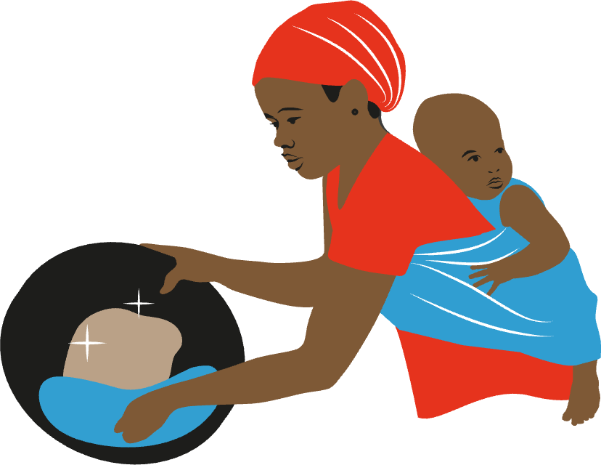
Artisanal and small-scale gold mining
More than 30% of the world's estimated 13 - 20 million artisanal miners are women; because gender norms shape perceptions that women are less suited for the heaviest labor mining tasks, the majority of women work in the processing aspects of artisanal mining, especially the mercury amalgamation process
Poverty is the main driver of women into mining, often underpinned by deterioration in subsistence farming.
  Artisanal and small-scale gold mining
  (ASGM) often uses toxic mercury to
  extract gold from ore. This sector
  is under high risk through direct
  exposure via amalgam burning,
  and through exposure
  to the fumes in the work-
  place and/or home.
3
MODULE

Slide 26
Placeholder here
  NAPs review highlights
  collaborated with UNEP on joint guidance to support gender mainstreaming in the development of artisanal and small-scale gold mining National Action Plans (NAPs)

Slide 27
Note to presenters: good place stop here and do an interactive exercise:
divide participants into small groups for easier discussion
ask participants to discuss amongst themselves two points:
are they aware of any prevalent patterns of mercury exposure in their country through ASGM, seafood consumption exposures, use of skin-lightning products or other exposures?
  if yes, how big a problem, how prevalent?
whether present in their country or not, can they think of effective strategies that might be used at local, national or global levels to limit or even eradicate these sources of mercury exposure? (presenter nudge: might include legal strategies or public awareness efforts)
  and what would be the best strategies to address the gendered dimensions of these issues?

Slide 28
4
MODULE
The Minamata Gender Action Plan

Slide 29
The Minamata Gender Action Plan is here to help
COP-5 adopted decision MC-5/15 which:
welcomed the gender action plan for the Minamata Convention on Mercury and
invited Parties and the Secretariat to implement priority activities under the gender action plan as part of the Programme of Work and Budget for the biennium 2024-2025
The gender action plan provides a comprehensive blueprint for actions to promote gender equality within all activities under the purview of the Convention.
The plan is organized around actions proposed for the Secretariat, Parties and other relevant stakeholders.

Slide 30
Adoption of the Gender Action Plan
COP-4
COP-3
COP-4 decision
MC-4/10 on gender
mainstreaming took note of the
gender road map and invited Parties,
inter alia, to support the Secretariat in
its efforts to mainstream gender into all activities to be undertaken by the Secretariat as well as by Parties and
other stakeholders, including thorough
the development of a gender
action plan for the Minamata
Convention during the
biennium 2022‒2023.
COP-3 decided
to include gender as a
focus area of the Convention’s
programme of work and budget
for the biennium 2020‒2021.
In particular, activity 13 of the programme of work includes the development of a gender strategy
with the objective of main-
streaming gender into the
programme of work.
COP-5
COP-5 decision
MC-5/15 welcomed the
gender action plan and
invited Parties to implement priority activities under the gender action plan as
integrated in the programme
of work and budget
for 2024-2025
2019
2020
2021
2022
2023

Slide 31
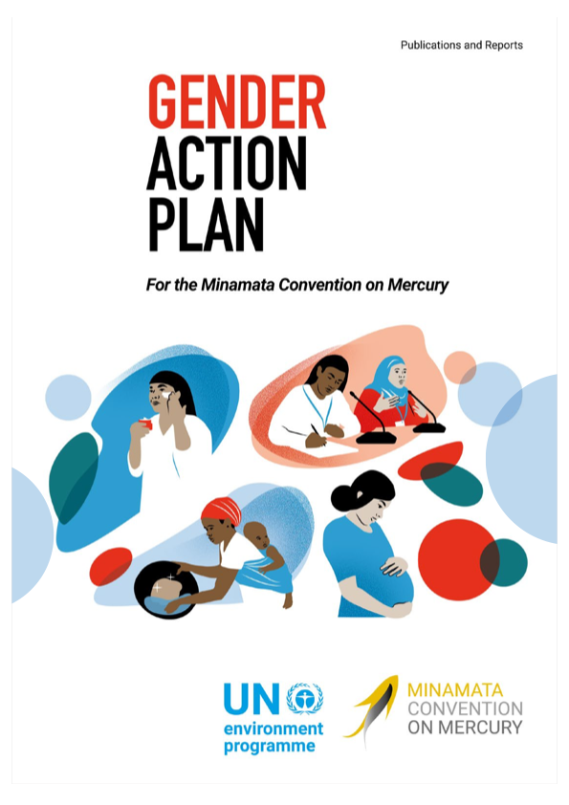
Purpose of the Minamata Convention Gender Action Plan
The gender action plan provides a comprehensive blueprint for actions to promote gender equality within all activities under the purview of the Convention.
The gender action plan provides guidance on possible actions, including targets and indicators of progress, to promote gender equality and mainstreaming within the Secretariat and in the Minamata Convention’s activities
undertaken by partners, Parties and
other stakeholders. The gender action
plan provides guidance on how to
translate equality and diversity
“principles” into specific actions
The full text of the gender
action plan is here.

Slide 32
More specifically
The purpose of the gender action plan is to support and advance a gender-responsive implementation of the Minamata Convention. Its overarching strategic objectives are:
To increase the effectiveness of the Minamata Convention by mainstreaming gender awareness throughout its implementation.
To foreground an understanding of social norms and gender identities that need to be taken into account to achieve the core goals of the Convention to protect human health and the environment from anthropogenic emissions and releases of mercury.
To amplify the Convention’s broad interest in and commitment to gender awareness, the gender action plan provides specific strategies and blueprints for possible actions to facilitate gender mainstreaming throughout the activities of the Secretariat, Parties and other stakeholders.

Slide 33
The gender action plan identifies possible gender mainstreaming actions by the Secretariat such as:
Establish internal Secretariat gender equality goals
Ensure that Secretariat staff, Parties and other key stakeholders are aware of the Minamata Gender Action Plan as well as other MEA gender action plans
Incorporate gender into existing trainings organized by the secretariat for Parties and other stakeholders
Ensure funding and resource mobilization for gender activities
Promote meaningful and inclusive participation in Secretariat processes and activities, including in COPs
Identify the gender capacity needs and interests of parties and other stakeholders
Ensure gender issues inclusion in national reports
Develop a dedicated website space for gender issues on the Convention home site
Ensure gender issues inclusion in National Action Plans (NAPS)
Ensure gender inclusion through the Specific International Programme
Facilitate knowledge sharing and mutual support
Develop Gender Progress Tracking and Review Mechanisms
Develop and disseminate knowledge on gender and mercury to the public and to Parties, taking into account gender disparities in access to information

Slide 34
Gender priority activities for the Secretariat during the 2024-2025 biennium
Review, according to gender considerations, of national reports submitted by parties under article 21 to identify measures related to the control of mercury-added products used primarily by women and children, such as cosmetics and dental amalgam;
Review of gender elements in existing national action plans submitted by parties pursuant to subparagraph 3 (a) of article 7 to establish a baseline for future reviews of national action plans, in collaboration with the Chemicals and Health Branch of the United Nations Environment Programme;
Development of case studies on the gender dimensions of projects funded by the Specific International Programme to Support Capacity-Building and Technical Assistance;
Continued inclusion of gender considerations in the process of appraising and evaluating projects under the Specific International Programme;
Delivery of gender-sensitive training in the development of project proposals in order to access funding under the financial mechanism of the Convention, in collaboration with the GEF secretariat;
Incorporation of gender elements into existing training, such as training related to mercury-added products, training for negotiators and potential chairs of contact groups and training in mercury wastes organized by the secretariat in cooperation with partners, such as the secretariat of the Basel, Rotterdam and Stockholm conventions and GEF;
Measurement of the meaningful participation of women in meetings of the Conference of the Parties, in Bureau meetings, in other official and expert meetings and in the processes and activities of the secretariat;
Promotion of efforts to identify “champions” to support the secretariat in its endeavour to mainstream gender into all activities to be undertaken by itself, by parties and by other stakeholders, in accordance with decision MC-4/10; 1
Sharing of parties’ surveys and requests for information to enable the secretariat to identify gender-related capacity-building needs and the interests of parties and other stakeholders.

Slide 35
The Gender Action Plan identifies possible gender mainstreaming actions by Parties and other stakeholders such as:
Ensure that national strategies and action plans include gender awareness and gender-inclusion goals.
Ensure that women are effectively included as members of all stakeholder groups consulted during national action plan development
Ensure that implementing partners effectively engage women as members of all stakeholder groups (and keep records of participation).
Support and develop gender integration in programmes and projects; develop guidelines to bring gender considerations into the planning and implementation of new and ongoing programmes and projects
Ensure meaningful inclusive repre-sentation and participation in COPs
Incorporate gender-disaggregated data and gender-specific indicators throughout activities
Ensure funding and resources for gender-sensitive and inclusive activities
Develop and disseminate knowledge about the importance of gender mainstreaming and the need to bring a gender lens into projects and activities
Build new constituencies and public awareness by connecting with and engaging women’s groups and actors who have not previously engaged with mercury issues
Develop public messaging about the dangers of mercury, taking into account gender disparities in access to information

Slide 36
Gender priority activities for the Parties and other stakeholders during the 2024-2025 biennium
Provision of gender-sensitive information, as appropriate, in their national reports to be submitted pursuant to article 21 of the Convention;
Incorporation of gender elements into the review of national action plans to be submitted in accordance with subparagraph 3 (c) of article 7 and subparagraph 1 (i) of annex C to the Convention;
Ensuring that gender-disaggregated data is included in the effectiveness evaluation process under article 22, in particular with respect to the monitoring of data on trends in the levels of mercury and mercury compounds observed in biotic media and vulnerable populations, in accordance with paragraph 2 of article 22;
Responding to surveys and requests for information to enable the secretariat to identify gender-related capacity-building needs and the interests of parties and other stakeholders;
Inclusion of gender considerations in the terms of reference for the next review of the financial mechanism;
Ensuring that there is gender balance in delegations to the meetings of the Conference of the Parties and other Convention-related meetings.
Thanks to the generous contribution od Sweden, the Secretariat is also developing and updating communication material to raise awareness on the gender action plan, including:
this training material for Parties on operationalizing the action plan
a publication and a pocket guide on the gender action plan

Slide 37
Gender-disaggregated data on participation at COP and other meetings
 | Total number (%) | Women | Men
COP-5 Government (HoD?) | 437 (11% N/A) | 46 | 43
COP-5 Observers | 235 (13% N/A) | 42 | 45
Bureau | 10 | 40 | 60
ICC | 15 | 60 | 40
SIP GB | 10 | 50 | 50
OESG + co-chairs | 53 | 32 | 68
Contact groups co-chairs (all COPs) | 38 | 40 | 60

Slide 38
5
MODULE
Mainstreaming gender in capacity-building projects: practical approaches

Slide 39
Mainstreaming gender in capacity-building projects: practical approaches

Slide 40
Gender mainstreaming in projects means taking gender into account throughout the project cycle in:
developing baseline analysis and assessment of priority needs and purpose
designing the project’s structure and project actions and strategies
its implementation
and monitoring and evaluation

Slide 41
Baselines and assessments of need
Use a gender lens in developing your baseline situational analysis:
    What is the nature of the problem?
    Have you identified gender-differentiated dimensions of “the problem”?
Identify priority needs and goals:
    What priority problem is your project intended to address?
    Did you consult with diverse constituents to identify those priorities?
    Who is defining the “problem” and is a gender lens incorporated into that?
Ask if ”reducing gender inequality” and/or women’s empowerment considered to be a priority need?
  If not, why not?

Slide 42

Planning the project structure, actions and activities
General approaches to defining WHAT your project will “do”:
How will your objectives be implemented?
What stakeholders will experience benefits and (perhaps) losses if your project is successful?
Are those benefits equitably and equally distributed across gender and other diversities?
If there are likely to be economic, livelihood, resource or other losses, are your mitigation/ remedial plans gender sensitive?
If “reducing gender inequality”
is a priority need (see above),
how will you do that?
Are you developing
mechanisms to collect
gender-disaggregated data?

Slide 43

Guidance from the Minamata Secretariat on project planning
Ensure you are identifying gender-specific exposures and impacts
Plan for inclusive stakeholder engagement and awareness raising
Recognize differentiated impacts of mercury management decisions
Plan for inclusive involvement in policy development and
decision-making
Engage all stakeholders in project management

Slide 44

Ensuring gender mainstreaming in applications to the Specific International Porgramme (SIP)…and the GEF
Gender mainstreaming is already an important part of the MC, and of the Secretariat support to Parties in the implementation of the Convention.
Article 13 of the Convention defines the financial mechanism, which is composed by the GEF and the SIP. There is also the related fund that supports implementation of the MC, the SP on institutional strengthening for the chemicals and waste cluster.
All of these support mechanisms require a focus on gender considerations in project development, review, reporting and evaluation – all with the aim of ensuring that implementation takes full account of gender aspects.
In the realm of chemicals and waste management, the gender-specific exposure routes and impacts are particularly important
Other aspects include:
Inclusive stakeholder engagement and awareness raising
Recognition of differentiated impacts of mercury management decisions
Involvement in policy development and decision-making
Engagement in project management
Secretariat delivered an online session to assist to Parties to bring gender mainstreaming into their work through the financial mechanism of the Specific International Programme to Support Capacity-Building and Technical Assistance (SIP) and Global Environment Facility.

Slide 45
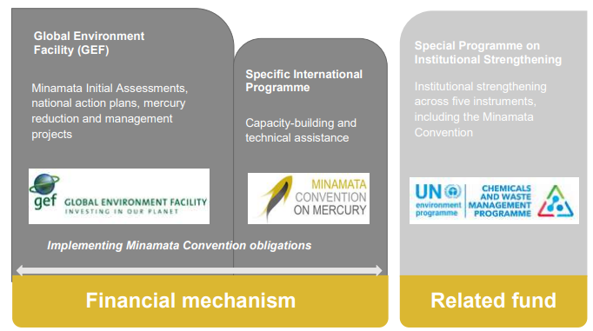
Gender and Convention
Implementation
Gender considerations in
project development, review, reporting and evaluation
Implementation
Roles of the various entities supporting the implementation of the Minamata Convention
Gender-specific
exposures and impacts
Inclusive stakeholder
engagement and
awareness raising
Recognition of differentiated impacts of mercury
management decisions
Involvement in policy
development and
decision-making
Engagement in project

Slide 46
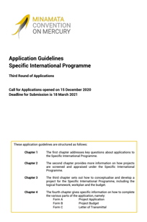
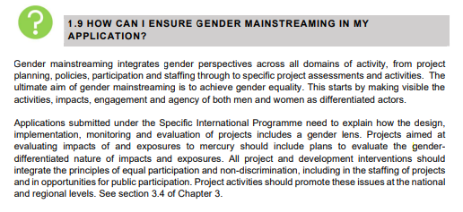
Mainstreaming gender in
SIP project applications
Gender lens
Project Design
Implementation
Monitoring
Evaluation
Applications guidelines for the Third Round
of applications to the SIP (LINK)
Sex-disaggregated data
Awareness-raising
Effective participation
Equal opportunity
Evaluating results

Slide 47

Guidance on SIP applications
Gender is one of the appraisal criteria and is a required application element (there is a specific section on gender in the project application form).
The “Application guidelines for the third round of applications to the SIP” provide information on how to ensure gender mainstreaming in the project application.
Applications submitted for SIP funding need to explain how the design, implementation, monitoring and evaluation of projects address gender considerations.
It is recommended to include gender indicators and targets in the Logical Framework
These indicators and targets could reflect activities such as:
Generating sex-disaggregated data that reflects the impacts of mercury pollution
Planning and organising awareness raising activities on the gender-differentiated impacts of mercury management (information materials and media that contains gender specific information could be produced, and in-person activities could be held at times that women are able to attend)
Promoting multi-stakeholder approaches to ensure effective participation of different groups, including women, in policy development and decision making
Creating terms of reference for project staff that ensure equal opportunity for women and men, and where applicable, require skills/expertise in gender
Monitoring and evaluating benefits, participation, and feedback among women and men during project activities and incorporate remedial action that promotes gender equality

Slide 48
Implementing the project
Is a gender lens embedded in implementation plans and processes?
Are you developing strategies that are based on the roles of women and men at work and at home?
Are the teams or actors who will actually be “doing” the project gender inclusive?
Do the teams or actors who will actually be “doing” the project need gender training? Are they aware of gender mainstreaming mandates and tools?
If you are doing in-field interviews or surveys, do you have capacity to hold same-sex interviews (women interviewing women/ men interviewing men)?
If public awareness activities are part of your plan, are you taking into account possible gender differences in access to information?

Slide 49

SIP
PROJECTS
Argentina project
SIP project “Capacity building programme for the implementation of the Minamata Convention”
Completed in December 2021
Report on “Mercury and gender issues” (Spanish)
  Found that coordination with key actors is crucial to identify the populations that are potentially at risk
  Suggested actions to advance public policies that provide women and pregnant women with the necessary care and support to avoid use of mercury dental amalgam.
ADDRESS
GENDER

Slide 50
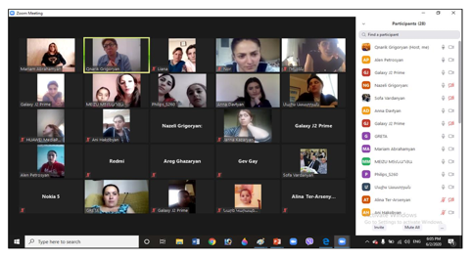
SIP
PROJECTS
Armenia project
SIP project “Strengthening capacity to promote phasing-out of mercury-added products (lamps)”
Completed in November 2021
Implementation of some activities carried out in close cooperation with the NGO “Armenian Women for Health and Healthy Environment” (AWHHE):
  Gathered data to study the distribution of lamps in different regions
  Developed awareness-raising campaigns in different regions.
ADDRESS
GENDER

Slide 51
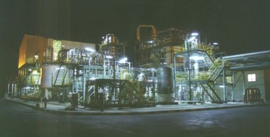

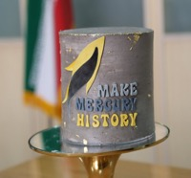
SIP
PROJECTS
Iran project
SIP project “Implementing of Minamata Convention on Mercury Management in Chlor-Alkali Plants in the Petrochemical Industry”
Completed in August 2021
Project on decommissioning of chlor-alkali plant in the petrochemical industry:
  Developed a Job Hazard Analysis tool for risk assessment focusing on gender-specific risk
  Women were part of the implementing team
  Developed guidelines on decommissioning of the plant, including environmentally sound management of its mercury wastes
ADDRESS
GENDER

Slide 52
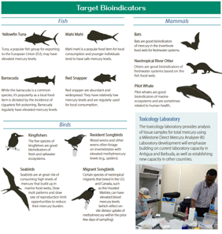


SIP
PROJECTS
Antigua and Barbuda project
SIP project “Facilitating Capacity-Building with Technical Assistance and Technology Transfer for Managing Mercury in the Caribbean”
Completed in October 2023
Established the Caribbean Region Mercury Monitoring Network to monitor mercury risks in the environment and the food chain, including studies of mercury levels in women of child-bearing age and testing of skin lightening products containing mercury
ADDRESS
GENDER

Slide 53
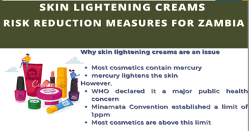
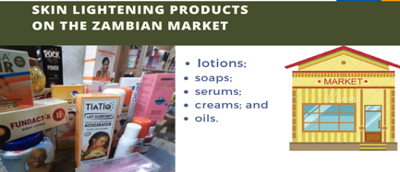
SIP
PROJECTS
Zambia project
SIP project “To strengthen the institutional capacity to implement the obligations of the Minamata Convention by reducing the presence of mercury in vulnerable populations”
Will end in August 2024
Project focusing on mercury-added products, especially skin-lightening creams and soaps:
  Evaluates the extent of mercury exposure through these products in vulnerable populations
  Conducts public awareness activities
  Develops a phase out strategy for mercury-added products, including skin lightening products
ADDRESS
GENDER

Slide 54
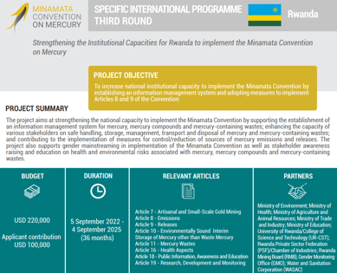
SIP
PROJECTS
Rwanda project
SIP project “Strengthening the institutional capacities to implement the Minamata Convention”
Will end in September 2025
Gender specific activities and indicators in the project logical framework:
  The Gender Monitoring Office will share expertise in gender mainstreaming
  Information materials and media containing gender specific information will be produced
  A national multi-stakeholder forum to highlight the impacts of mercury on gender will be organized
ADDRESS
GENDER

Slide 55
Some gender activities by projects
(TO BE UPDATED WITH SIP CASE STUDIES)

Slide 56

Monitoring and evaluation
Are you prepared to include the following aspects in your monitoring and evaluation assessments?
the extent to which gender gaps have been reduced
whether gender equality/women’s empowerment has been improved
what results gender-disaggregated information provide

Slide 57
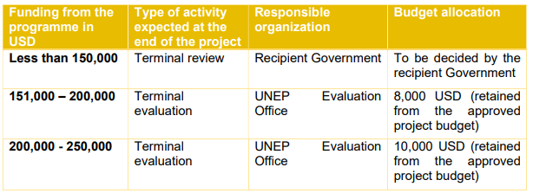
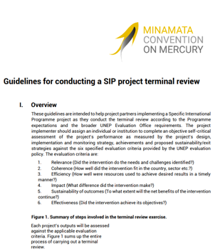
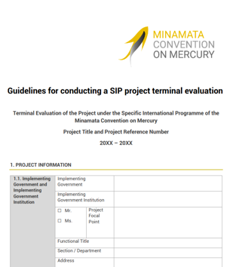


Gender in SIP project terminal review/ evaluation
Guidelines for conducting a SIP project terminal review (LINK)
Guidelines for conducting a SIP project terminal evaluation (LINK)

Slide 58
Note to presenters: end here with an interactive exercise:
This exercise is intended to capture “takeaway lessons/ reflections/ next steps” from participants.
Suggest this be done individually (not in groups). Ask the participants to write down reflections on any variations of these 3 items (depending on the nature of the participant group):
if you are currently planning a project on reducing harms from mercury exposure, what are three main lessons/tips/ideas you take away from this training that you will be sure to introduce into your planning
if you are already in the midst of a project, can you identify two or three improvements you will make/ suggest as a result of this training?
if you were asked to give gender advice to a team developing a project, can you identify two or three improvements you will make/ suggest as a result of this training
allow about 10-15 minutes, then call on 4 or 5 participants to share (or more, depending on timing)

Slide 59
Resources
OVERVIEW: https://minamataconvention.org/en/gender
FACT SHEET: https://Minamataconvention.org/sites/default/files/documents/2021-08/Gender_Equality_Mercury_May_2021.pdf
COURSE on gender and mercury: https://elearning.informea.org/course/search.
php?q=mercury%20gender&areaids=core_course-course%22%20\t%20%22_
blankand
For ASGM projects: A quickstart guide: https://www.planetgold.org/
sites/default/files/Gender%20guide%20visual%20summary_080221.pdf
NAP review (ADD LINK WHEN AVAILABLE)
INFORMATION SESSIONs:
  Promoting gender in the implementation of the Convention https://minamataconvention.org/en/events/https://minamataconvention.org/en/events/promoting-gender-equality-implementation-convention
  Mainstreaming gender in capacity-building projects: practical approaches
SIP case studies (ADD LINK WHEN AVAILABLE)
VIDEO(S): https://www.youtube.com/watch?v=CiM0dmGr1Gs
Gender focal point within the Secretariat, Lara Ognibene, Legal Officer, lara.ognibene@un.org

Slide 60
Thank you for your attention

