Slide 1








Supported by
Produced by
From monitoring to resilience:
Cryosphere information services
in Central Asia

Slide 2

Contents
Cryosphere information services – Potential applications
The cryosphere – A few fundamentals
Value cycle for cryosphere information services
Case studies
Human connections and capacity development
Recommendations
Further information and links
Supported by
Produced by
From monitoring to resilience: Cryosphere information services in Central Asia
2

Slide 3
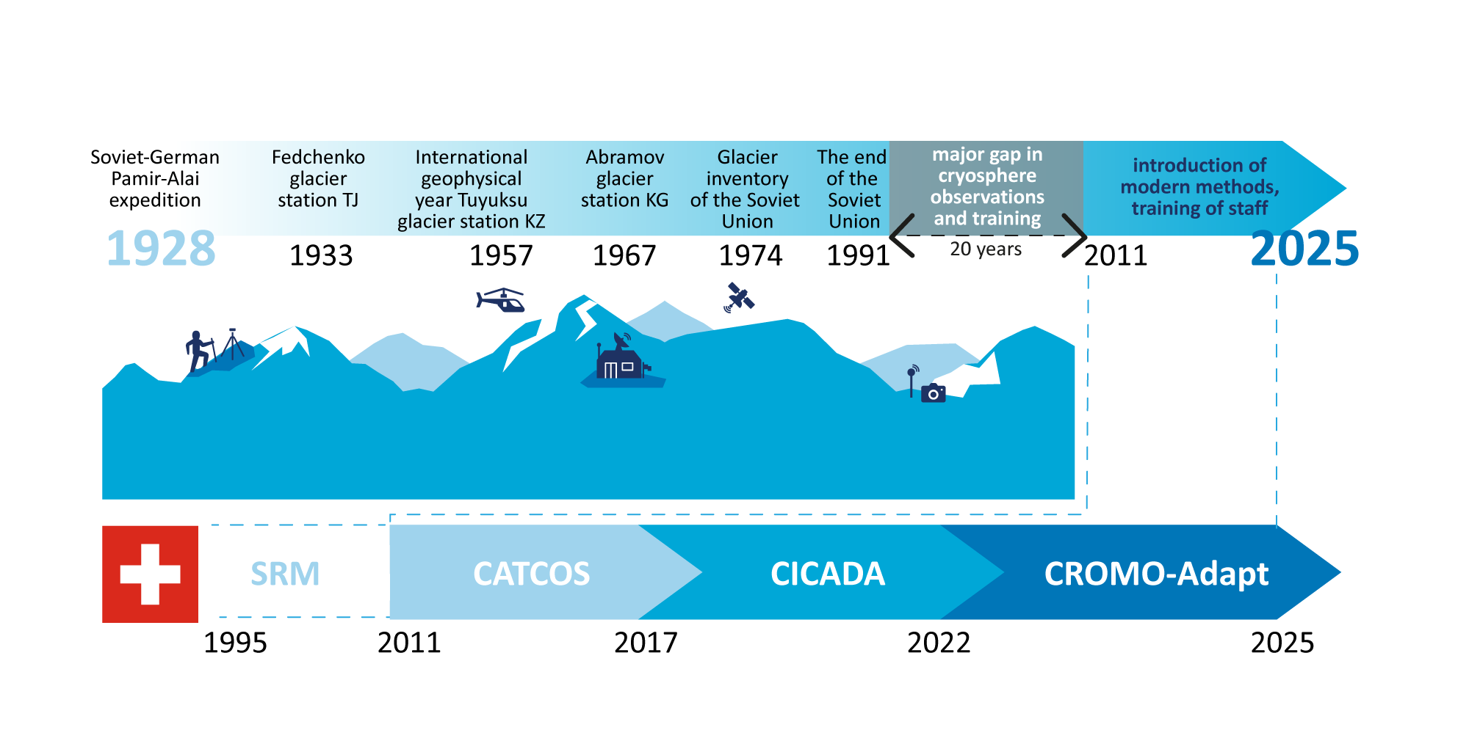

Timeline 100 years of hydromet and cryosphere observations
14 years of cryosphere engagement of Switzerland in the Mountains of Central Asia
Timeline Swiss snow & glacier projects – past 30 years
Supported by
Produced by
From monitoring to resilience: Cryosphere information services in Central Asia
3

Slide 4






Cryosphere information services - Potential applications
Is winter tourism development possible in this area?
Should
we adjust hydropower production based on snowmelt projections?
Is the tailing dam stable and not at risk from rock fall due to thawing permafrost?
Will we need
to pause or divert the traffic due to high avalanche risk?
How much irrigation water can I expect in the upcoming season?
Supported by
Produced by
From monitoring to resilience: Cryosphere information services in Central Asia
4

Slide 5





Cryosphere information services – Potential applications
Farmers and pastoralists use information about water availability to adjust farming calendars, grazing routes, or prepare for flooding risks.
Responsible authorities,
community leaders and private actors use avalanche data to inform populations of increased avalanche risks.
Spatial planners use avalanche hazard and risk information to guide safe development of winter tourism infrastructure.
Researchers use cryosphere monitoring data to constantly improve their understanding of the current change and future projections.
Water utility providers use snow and glacier melt data and projections to analyze seasonal water availability and plan water supply.
Supported by
Produced by
From monitoring to resilience: Cryosphere information services in Central Asia
5

Slide 6




Cryosphere information services – Potential applications
Hydropower managers use cryosphere and hydrological information for the projection of energy production and for the conflict-free management of reservoir vs downstream irrigation needs.
Engineers, architects and builders use permafrost data and projections to assess the stability of the terrain before building roads, pipelines, or infrastructure.
Ski resort managers use snow cover data and projections to analyse future snow reliability to evaluate the economic feasibility of building in specific locations.
Mining engineers use permafrost monitoring data to assess ground stability for safe geo-exploration and mining infrastructure.
Supported by
Produced by
From monitoring to resilience: Cryosphere information services in Central Asia
6

Slide 7
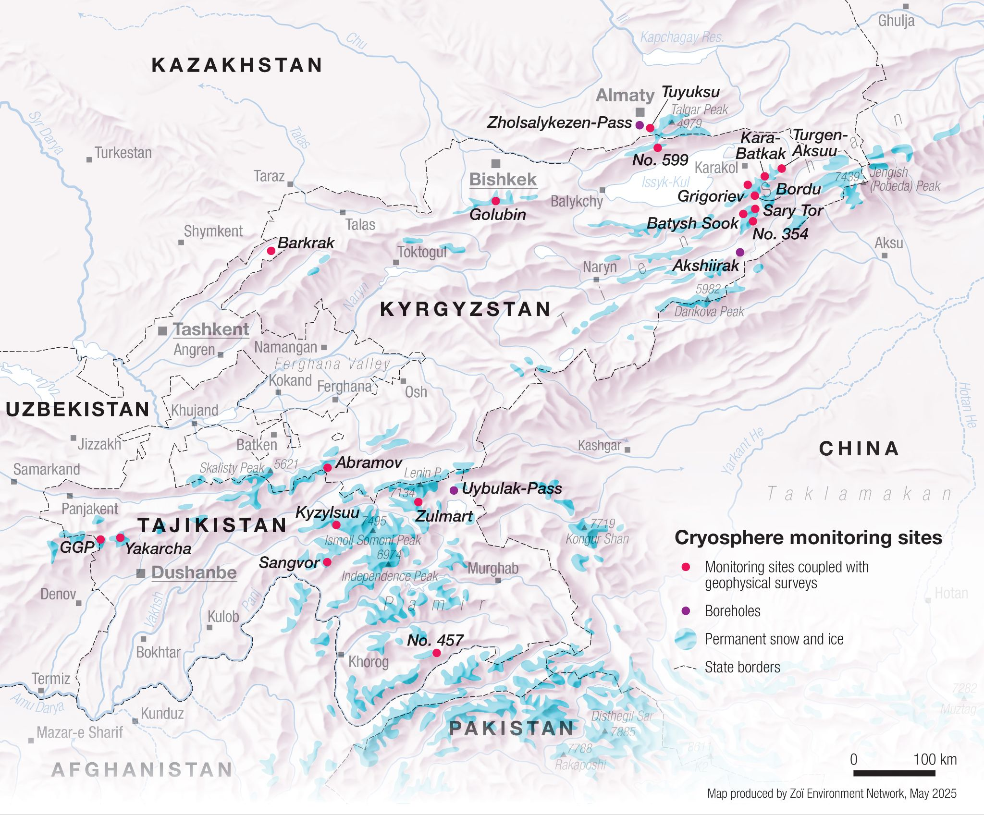
The cryosphere in Central Asia
The glaciers of Central Asia contain about 3200 km³ of water reserves.
The CROMO-ADAPT Project supports
16 monitoring sites and
3 boreholes.
Supported by
Produced by
From monitoring to resilience: Cryosphere information services in Central Asia
7

Slide 8
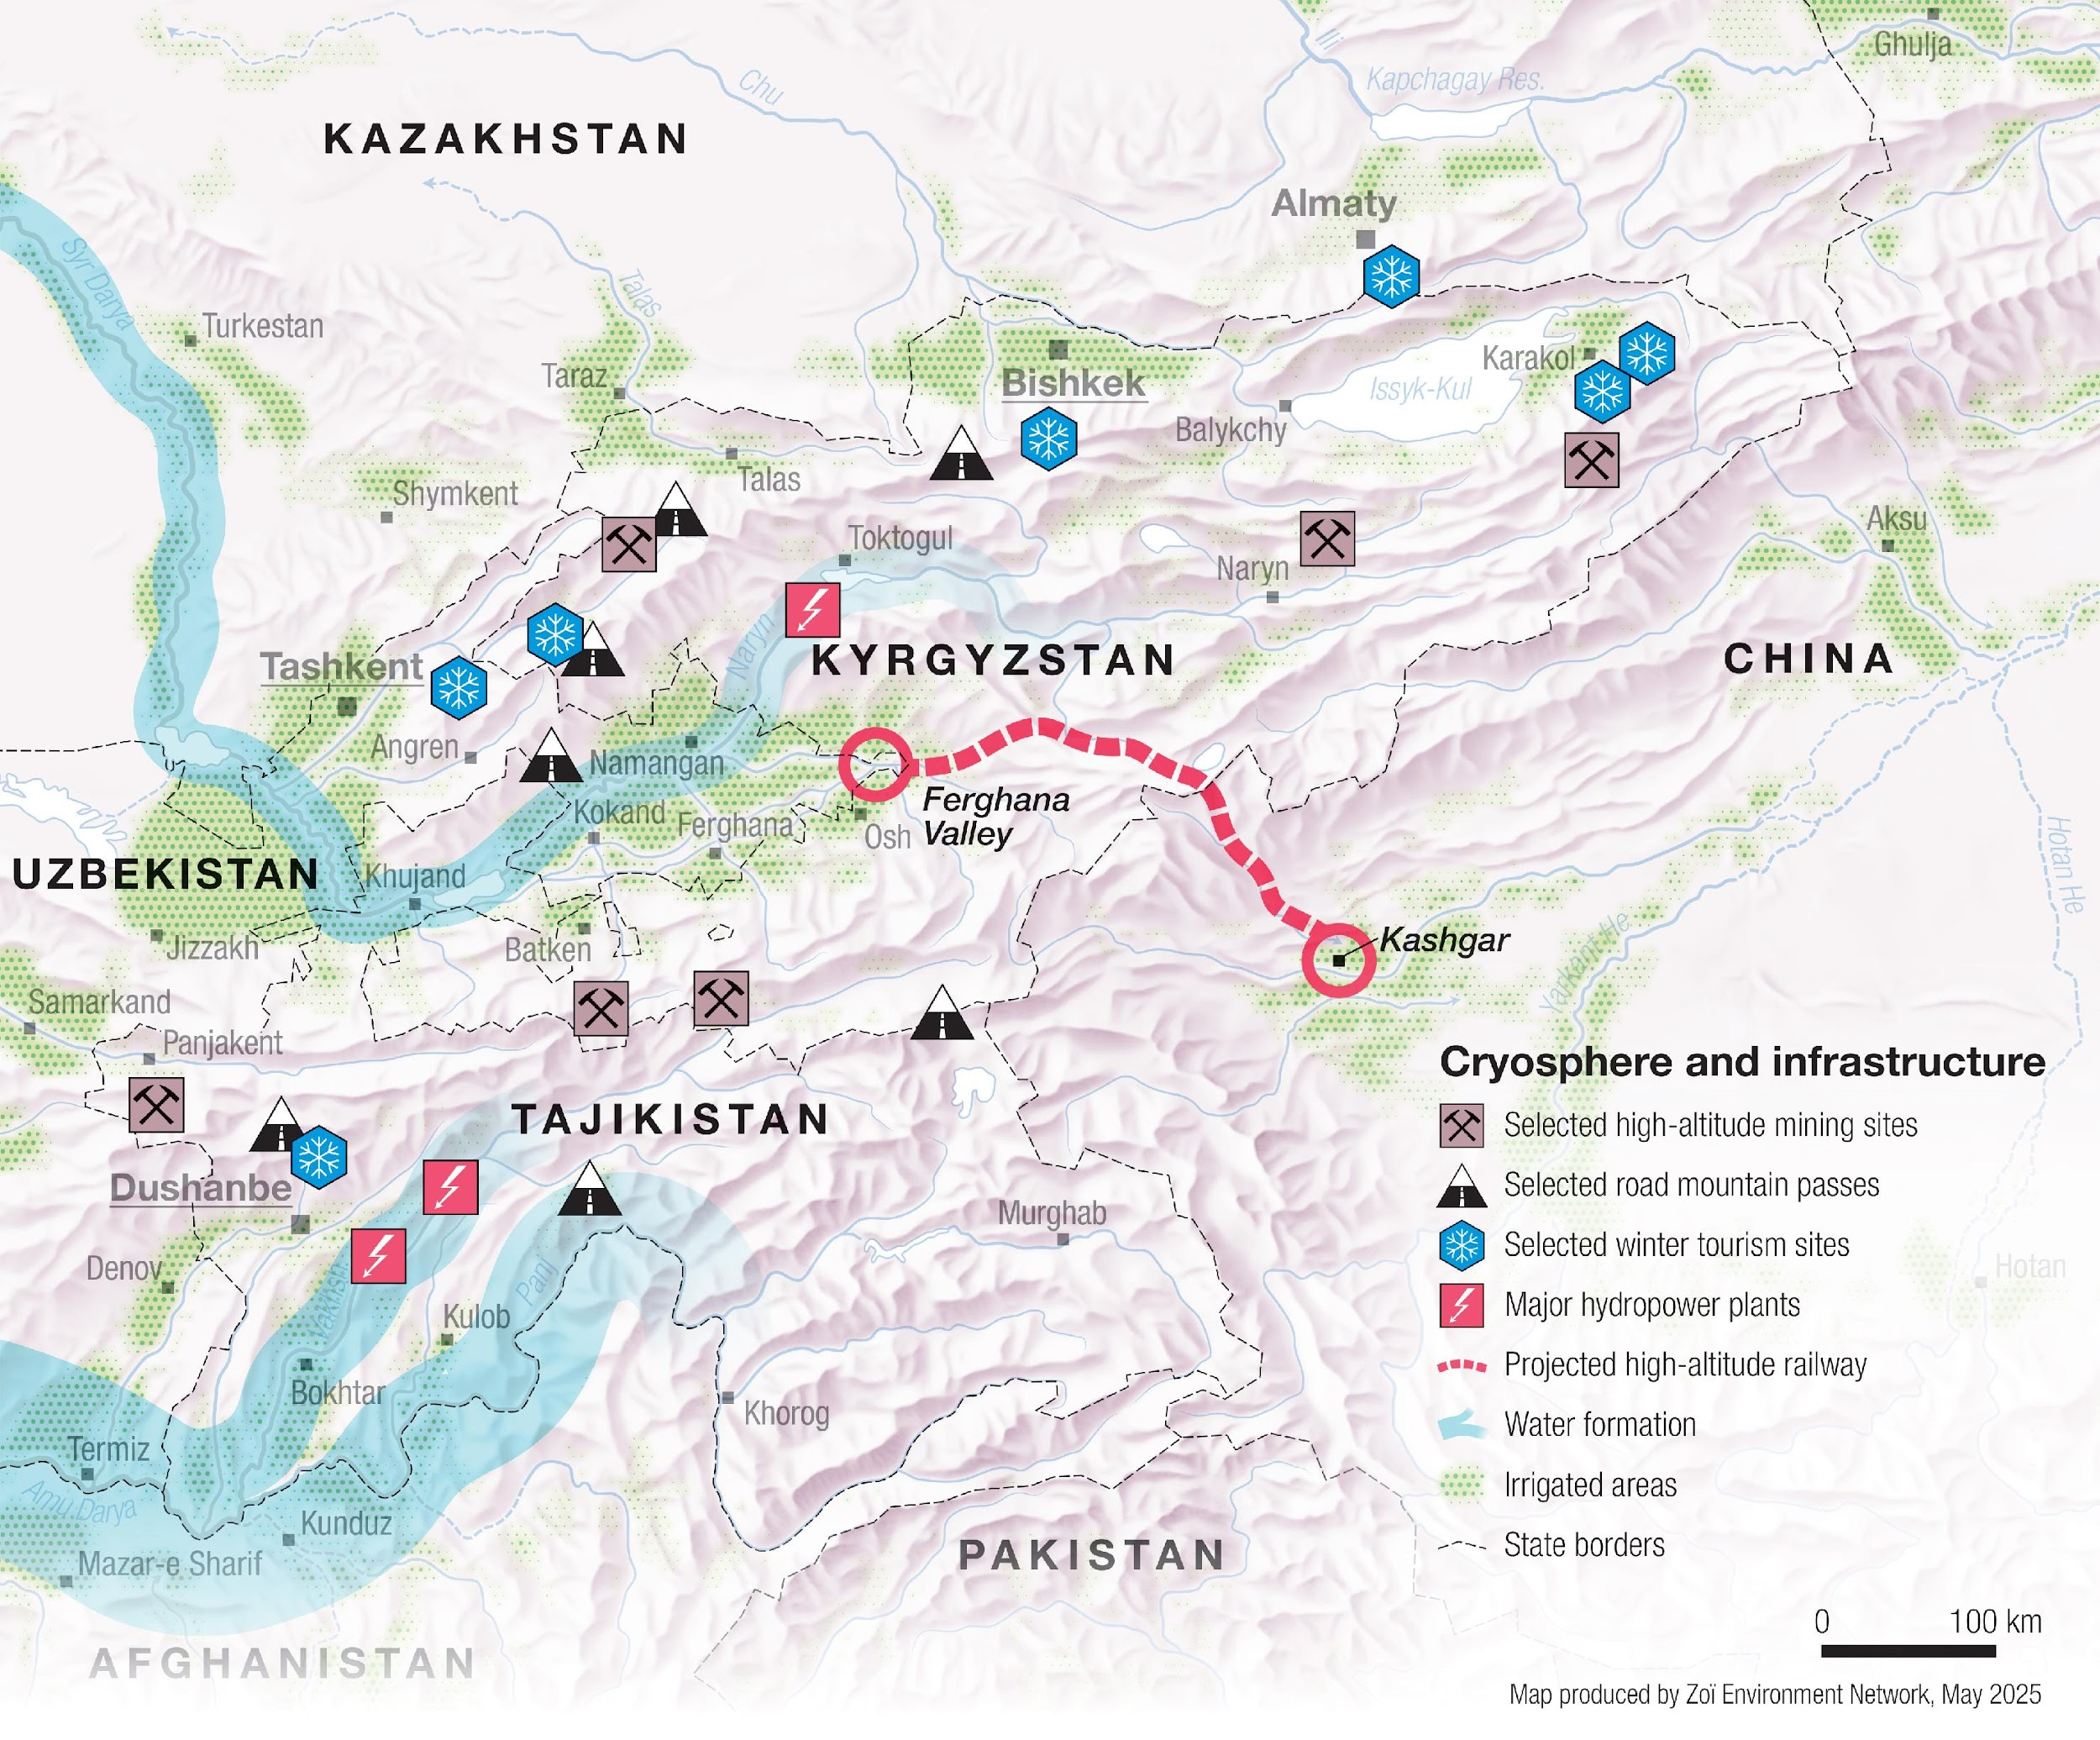
The cryosphere in Central Asia
High-elevation hydropower, winter tourism, mining sites and roads, and downstream agriculture are directly dependent on the state of cryosphere.
Supported by
Produced by
From monitoring to resilience: Cryosphere information services in Central Asia
8

Slide 9
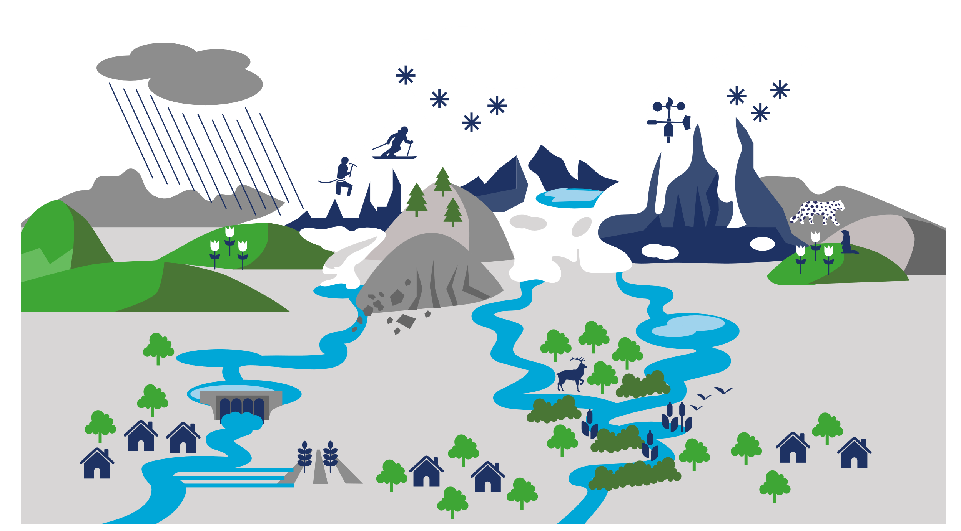
The cryosphere and its benefits
Seasonal
snow cover
Glaciers
Winter
sports
Lake and
river ice
Unique
species
Communities, economies, and ecosystems all depend on the multiple benefits provided by the cryosphere.
Permafrost
Hydropower
production
Water quality
and biodiversity
Settlements
Agriculture
Transboundary rivers
Wetlands
Supported by
Produced by
From monitoring to resilience: Cryosphere information services in Central Asia
9

Slide 10
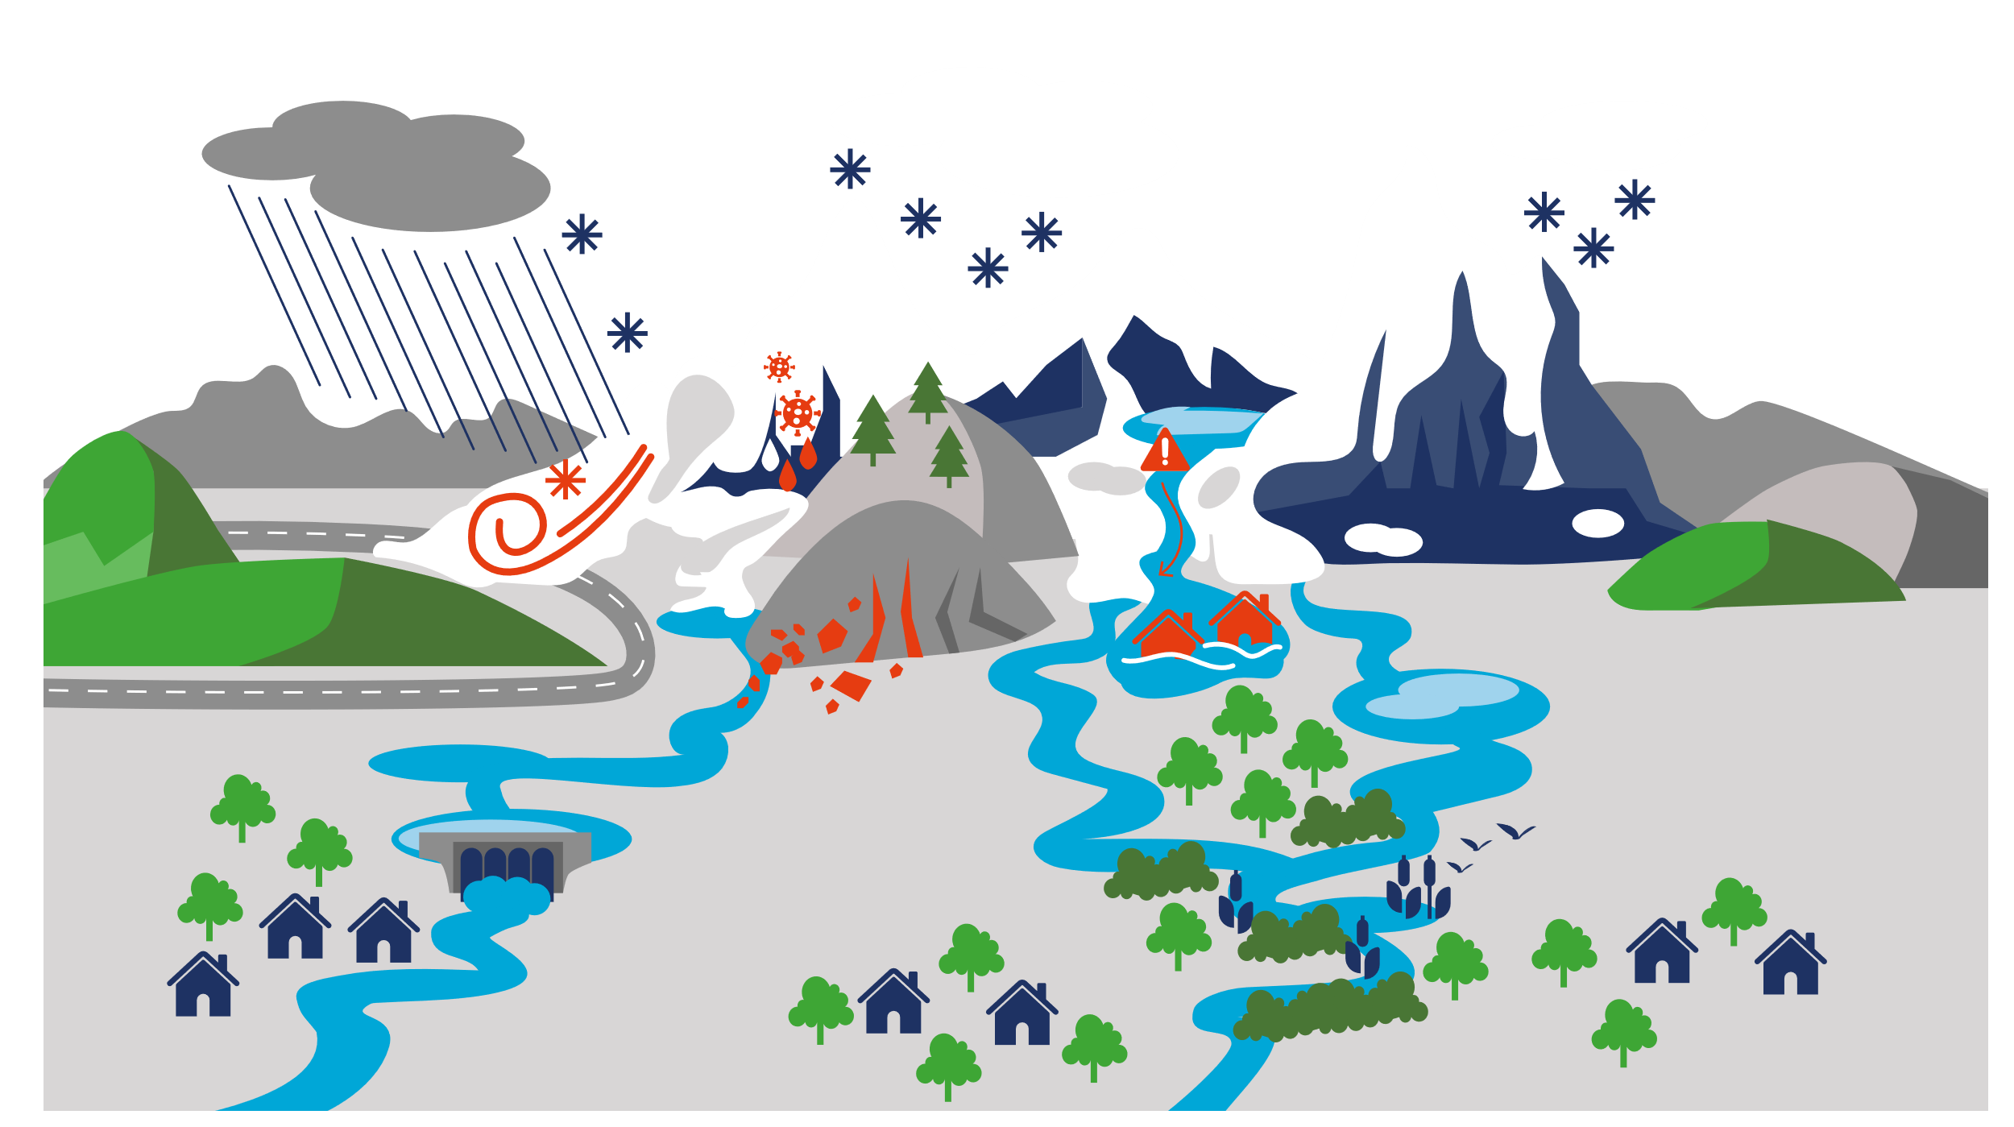

The cryosphere and its risks
Seasonal
snow cover
Glacier melt, snow cover decline, and permafrost thaw due to climate change are increasing the risks to infrastructure, energy production, water supply, economic activities, and livelihoods.
Glaciers
Lake and
river ice
Diseases,
biosafety
Avalanche
hazard
Permafrost
Floods
Rock stability,
rockfalls
Change in
water flow
Supported by
Produced by
From monitoring to resilience: Cryosphere information services in Central Asia
10

Slide 11


The cryosphere
MEASUREMENTS
Remote
sensing
Meteorological
stations
SELECTED
PARAMETERS
Snow depth
gauge
DATA AND SERVICE USERS
Snow water
equivalent
Icy roads,
risk of avalanches
Rapid snow melt,
snow-related hazards
Snow
Extreme weather
warnings for agriculture
Snow cover
extent and depth
Snow data and services span time horizons from hours to decades.
Water availability
for crops
Hours
Days
Years
Decades
Time horizon
Supported by
Produced by
From monitoring to resilience: Cryosphere information services in Central Asia
11

Slide 12

The cryosphere
MEASUREMENTS
Remote
sensing
SELECTED
PARAMETERS
DATA AND SERVICE USERS
Temperature
at depth
Rock
stability
Road conditions
and safety
Permafrost
Mining and
tailing safety
Water availability
for crops
Temperature
profile
Permafrost data
and services span time horizons from seasons to centuries.
Water reserves
in the frozen
ground and rocks
Time horizon
Seasons
Years
Decades
Centuries
Supported by
Produced by
From monitoring to resilience: Cryosphere information services in Central Asia
12

Slide 13
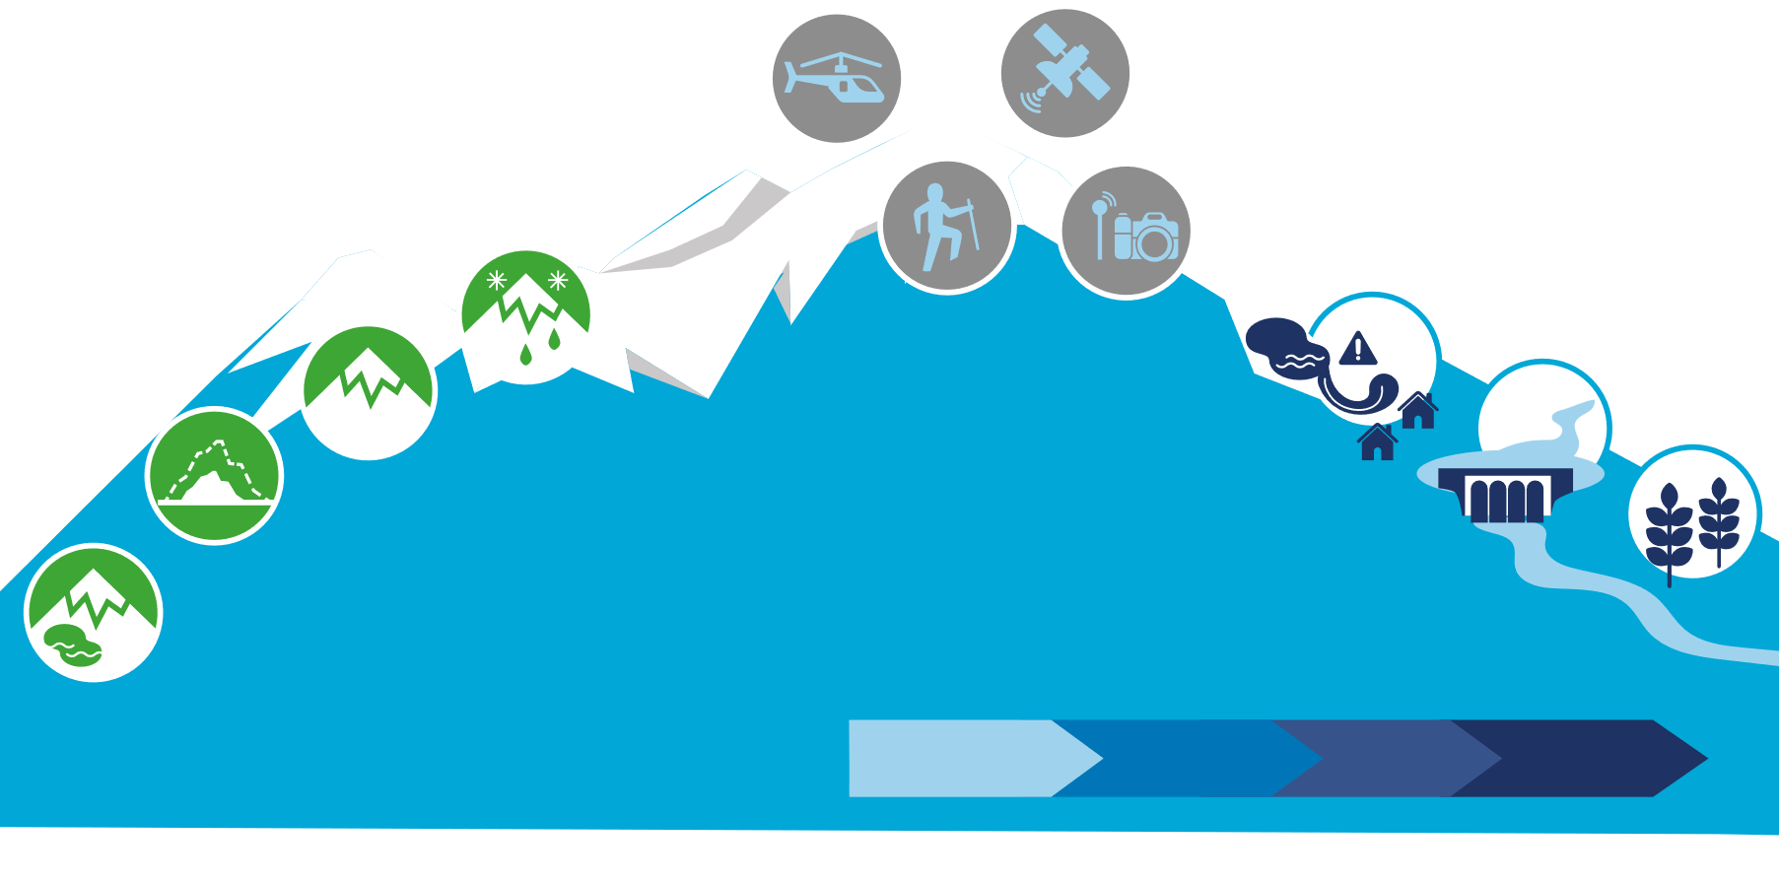
The cryosphere
MEASUREMENTS
Aerial surveys
Remote
sensing
SELECTED
PARAMETERS
Cameras and
sensors on glaciers
Glacier surveys,
expeditions
DATA AND SERVICE USERS
Risk of glacial lake outburst floods (GLOFs)
Glacier mass
balance
Glacier
Glacier area, volume and length
Water inflow into reservoirs, hydropower planning
Glacier surges
Glacier data and services span time horizons from days to decades.
Water availability
for crops
Time horizon
Stability and number
of glacial lakes
Days
Seasons
Years
Decades
Supported by
Produced by
From monitoring to resilience: Cryosphere information services in Central Asia
13

Slide 14
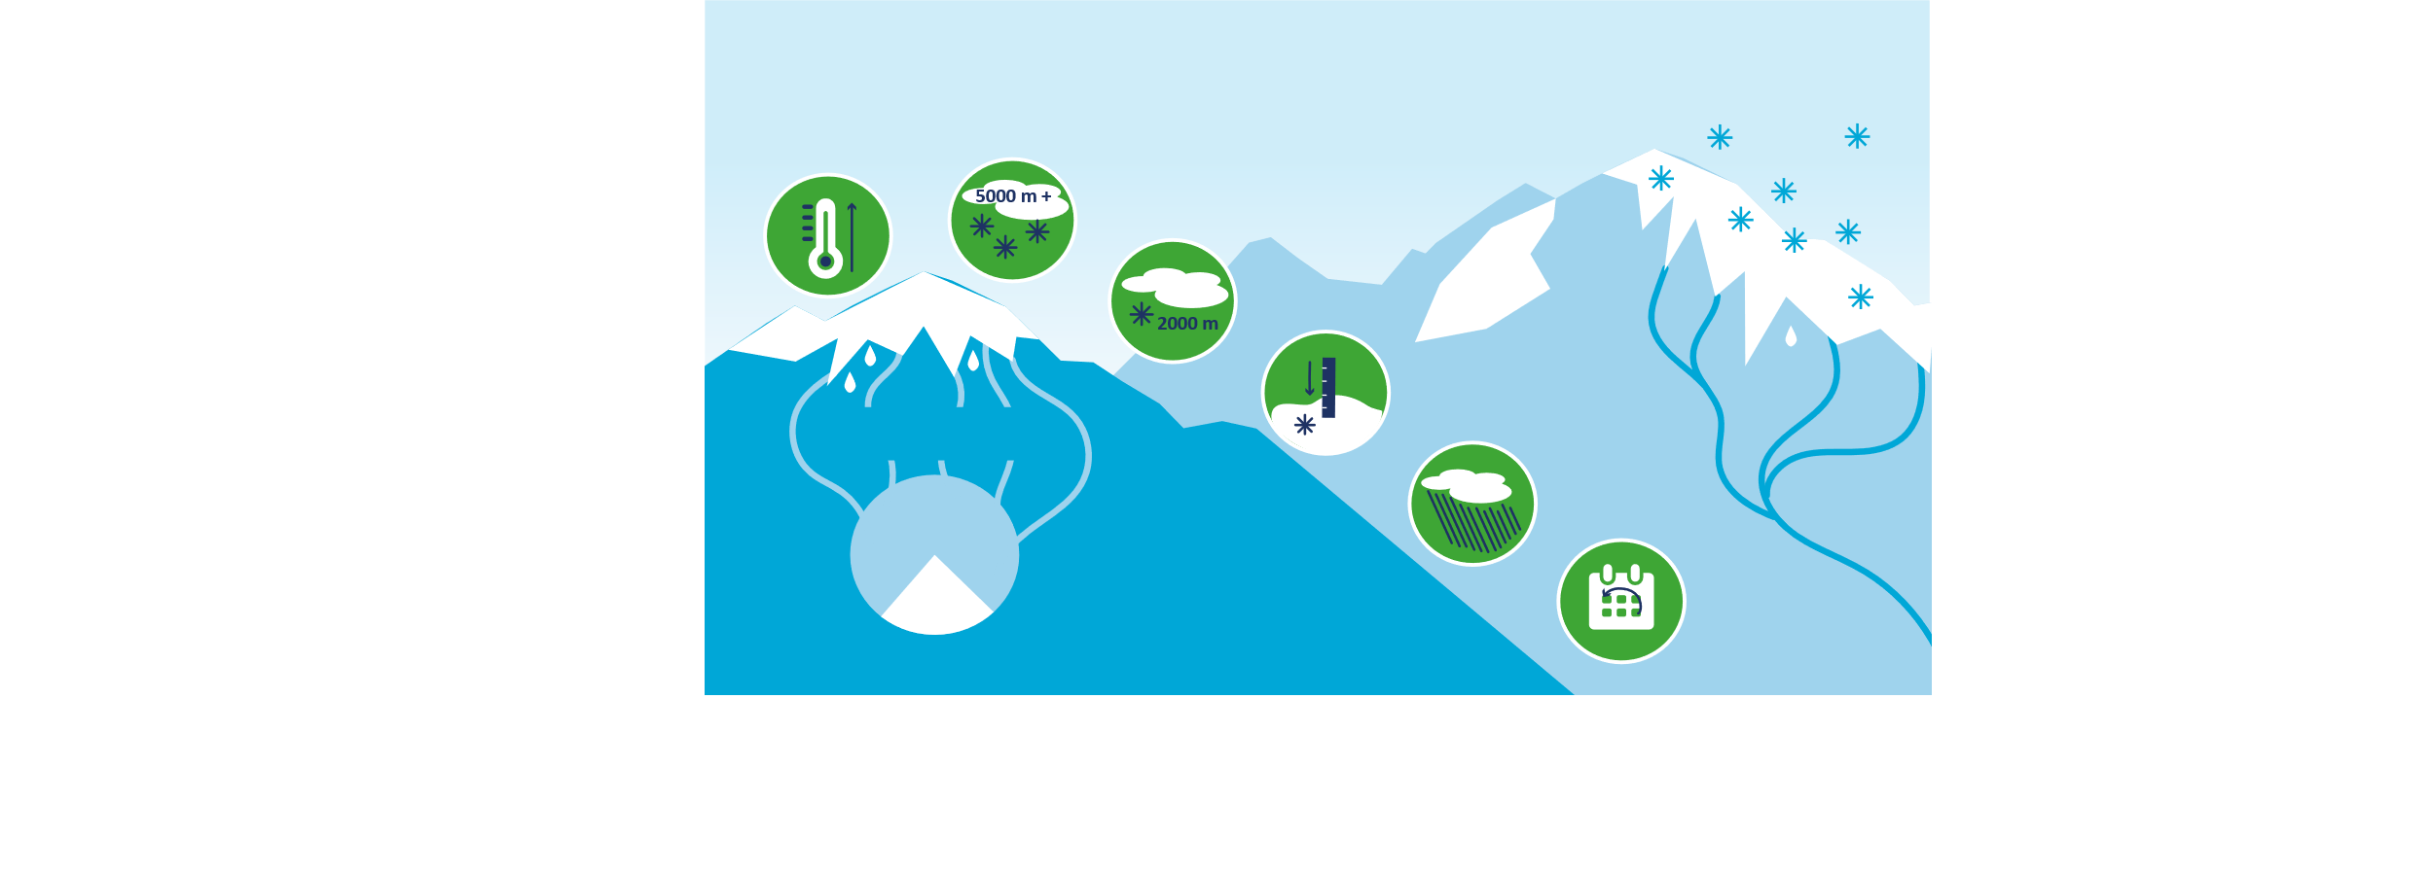
Scenarios for snow
Increase in winter precipitation and runoff at high elevations
Reduction in snow cover and albedo at lower elevations
Warming in air and ground surface temperature
Decrease in snow elevation, extent and snow water equivalent everywhere, except in Eastern Pamir
Share of snow melt water
in annual river runoff
More rain instead of snow, rain on snow events and floods
65-75%
Rain
water
Shifts in snow duration and melting dates
Supported by
Produced by
From monitoring to resilience: Cryosphere information services in Central Asia
14

Slide 15


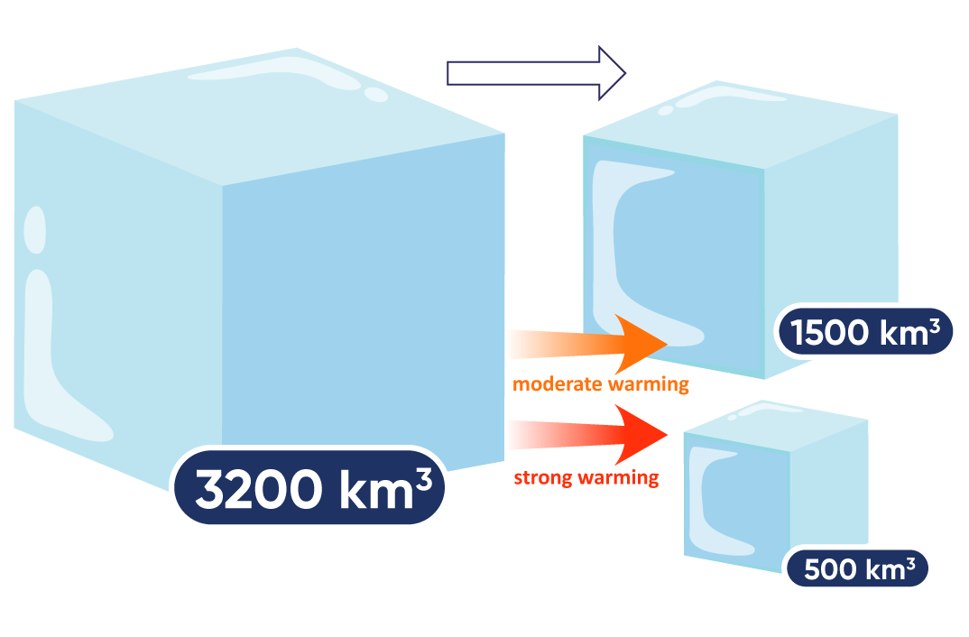
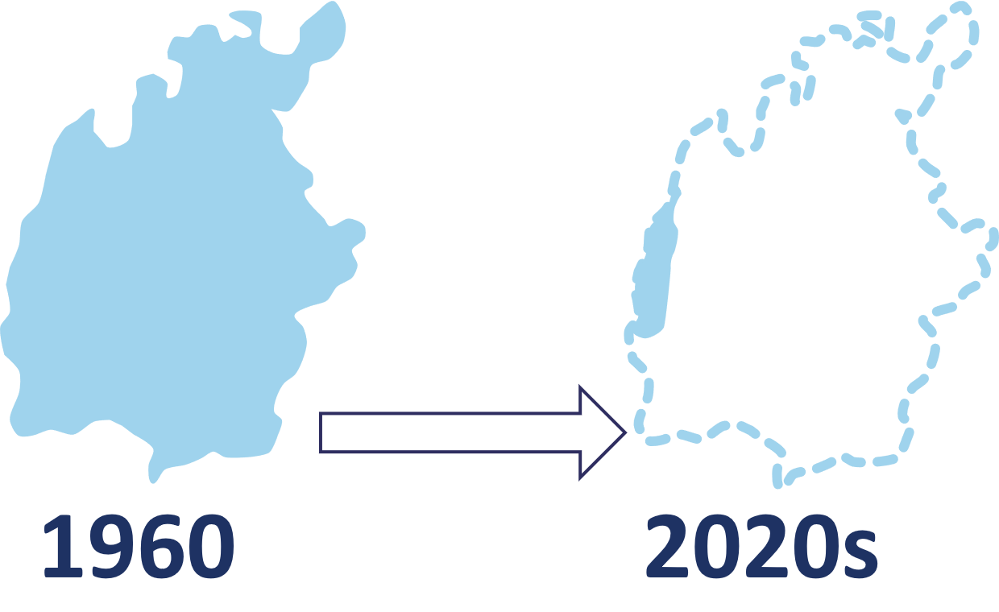
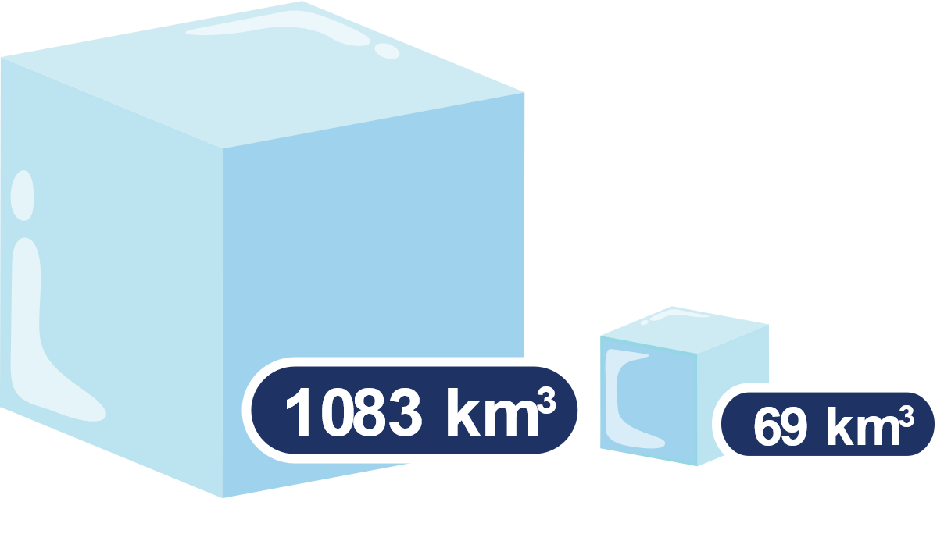
Scenarios for glaciers
The projected reduction of water resources in the glaciers of Central Asia is immense and can be compared to the decline in the water volume of the Aral Sea.
Projected reduction
in 70 years
Water reserves
in the glaciers
of Central Asia
Water volume of the Aral Sea
Supported by
Produced by
From monitoring to resilience: Cryosphere information services in Central Asia
15

Slide 16

Value cycle for cryosphere information services
User
Requirements
Cryosphere information services depend on interconnected activities that create
a benefit for end users provided the cycle is closed.
Observation
& Stations
User Decisions
& New Insights
Data
Management
Service
Dissemination
Forecasting
& Projections
Service
Development
Supported by
Produced by
From monitoring to resilience: Cryosphere information services in Central Asia
16

Slide 17
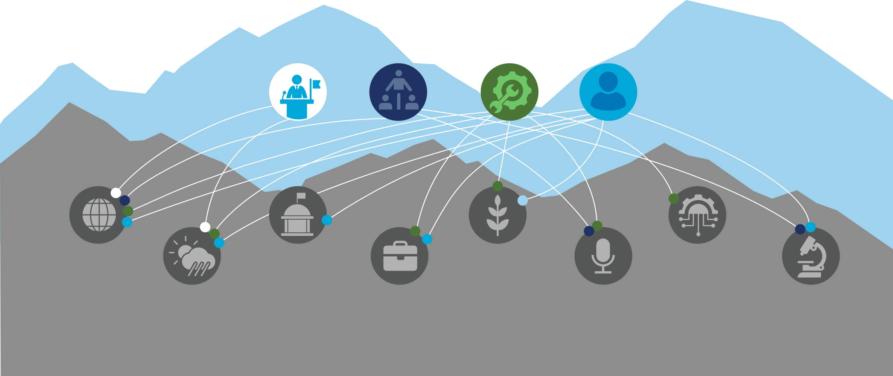

Value cycle for cryosphere information services
Engaging
the stakeholders across the cryosphere value cycle is essential in ensuring actionable cryosphere information
services.
Main roles
Policy maker
Intermediary
Service provider
User
Stakeholders
WMO, GCOS and
other multilateral
organisations
Ministerial departments
and other national
authorities
Communities, farmers
and pastoralists
Information and
communication
technology
providers (ICTs)
National meteorological and
hydrological service (NMHS)
Private companies
and economic actors
Media
Research institutions
and academia
Supported by
Produced by
From monitoring to resilience: Cryosphere information services in Central Asia
17

Slide 18




Human connections and capacity building
Engaging in cryosphere information services has co-benefits.
Skills development and strengthening of local expertise
Enhance capacity through training, higher education, knowledge transfer, and hands-on involvement in monitoring, modeling, data interpretation and service delivery.
Linkages to international cooperation and international initiatives
Open opportunities for collaboration with global scientific networks, climate adaptation initiatives, and policy frameworks (e.g. UNFCCC, WMO).
National to regional network strengthening
Fosters collaboration and data and knowledge exchange across countries and institutions.
Supported by
Produced by
From monitoring to resilience: Cryosphere information services in Central Asia
18

Slide 19








Human connections and capacity building
400+ Local scientists trained: Equipping scientists with the skills to perform high-quality monitoring.
20+ PhD students co-supervised: Ensuring that the next generation of cryosphere experts is well prepared.
30+ Cryosphere Monitoring sites: Providing comprehensive baseline data in all climate regions.
20+ Study visits to Switzerland: Providing students with international exposure and advanced training.
50+ Women participating in “Adventure of science: Women and glaciers in Central Asia”: Ensuring that women have a strong voice and active role in cryosphere research and exploration.
18 Modelling tools and services developed: Providing access to cutting edge technology.
200+ Participants in Summer Schools and Workshops: Offering students hands-on learning experiences.
Key results of CROMO-ADAPT and previous projects
Annual Regular GTN-G (WGMS), GTNP & WMO submissions: Ensuring global visibility and access.
Supported by
Produced by
From monitoring to resilience: Cryosphere information services in Central Asia
19

Slide 20




Policy recommendations
Improve cryosphere information services by aligning them with user needs and by making use of cost-efficient and robust technology. Enhance mutual understanding between users and providers, establish supportive legal and institutional frameworks, and invest in low-maintenance monitoring and service dissemination solutions.
Improve data exchange by establishing data-sharing mechanisms among countries and sectors. Support interoperability across platforms, and promote open access policies that ensure timely, transparent, and coordinated use of cryosphere data.
Strengthen local and national expertise in cryosphere research through the development of training programmes and the promotion of citizen science, and secure funding through smart investments and multi-stakeholder partnerships.
Develop and implement demand-driven and demand-triggering projects through ongoing engagement with users and by designing modular projects that can be adjusted for emerging needs and that contribute to National Adaptation Plans.
Supported by
Produced by
From monitoring to resilience: Cryosphere information services in Central Asia
20

Slide 21





Potential applications for end users
Recommendations for end users
Hydropower and irrigation
  Check forecasts on seasonal water availability and contribution of meltwater from snow and glaciers
  Plan hydropower operation based on sub-daily resolution forecasts
  Consider slope stability and long-term changes in water flow for strategic and long-term planning
Roads and transport
  Check forecasts on severe weather (including visibility) and snow avalanche risk
  Monitor rock stability and permafrost at high altitude sections and consider these
  in road planning and safety
Mining at altitude
  Use data on timing, extent and depth of snow cover, risk of avalanches
  Monitor ice and rock stability and permafrost and consider these in industrial safety
  Model long-term stability of sites for safe tailings operation and waste management
Mountain tourism
  Use data on timing and depth of snow cover, risk of avalanches
  Ask site-specific long-term snow and cryosphere modelling to plan or modify ski resorts and infrastructure
  Check forecasts and warnings on severe weather
  Check data on glaciers and glacial flood risk
Disaster risk reduction (DRR) and National Adaptation Plan (NAP) processes
  Use risk and impact scenarios for DRR and for National Adaptation Plan process
  Use sectorally relevant data for line ministries and other agencies
Supported by
Produced by
From monitoring to resilience: Cryosphere information services in Central Asia
21

Slide 22
Links
National hydromet services (NHMS) sites:
  Kazakhstan: kazhydromet.kz
  Kyrgyzstan: meteo.kg
  Tajikistan: meteo.tj
  Uzbekistan: hydromet.uz
National and regional cryosphere websites:
  Kazakhstan and Central Asia (Regional glacier centre): cargc.org
  Tajikistan: cryosphere.tj
SnowMapper – Snow situation in Central Asia
  Central Asia Mountains dashboard: snowmapper.ch
  Tajikistan: taj.snowmapper.ch
Adventure of Science: Women and glaciers in Central Asia: inspiringgirls.org/central-asia-en
World Glacier Monitoring Service WGMS: wgms.ch
Global Cryosphere Watch: globalcryospherewatch.org
Supported by
Produced by
From monitoring to resilience: Cryosphere information services in Central Asia
22

Slide 23
Links
Further resources and projects:
  UN World Water Development Report 2025, Mountains and glaciers, Water towers: https://www.unwater.org/publications/un-world-water-development-report-2025
  Central Asia Hydromet atlas: https://zoinet.org/product/hydromet-atlas
  Knowledge products from GLOFCA – Glacier lake outburst floods in Central Asia UNESCO-AF project: https://glofca.org/resources-for-science-and-policy
  PAMIR project - From ice to microorganisms and humans: Toward an interdisciplinary understanding of climate change impacts on the Third Pole: https://pamir-project.ch
Supported by
Produced by
From monitoring to resilience: Cryosphere information services in Central Asia
23

